Slide 1
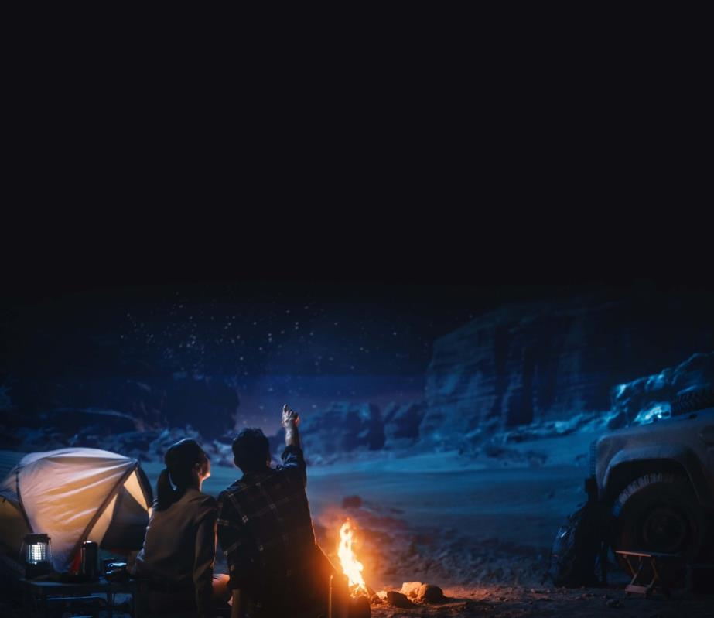
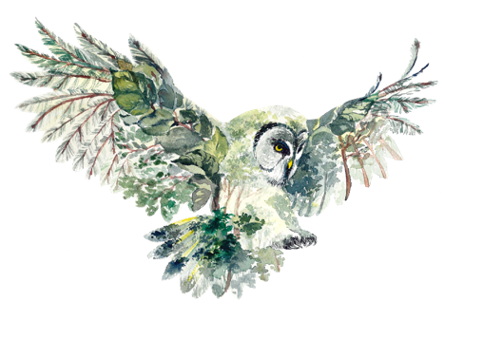

MODULE 1
INTRODUCTION TO DARK SKY ECOTOURISM
www.darkskytourism.eu
Dark Sky Ecotourism VET Programme © 2023 by Dark Sky Ecotourism Consortium is licensed under CC BY-SA 4.0
Funded by the European Union. Views and opinions expressed are however those of the author(s) only and do not necessarily reflect those of the European Union or the European Education and Culture Executive Agency (EACEA). Neither the European Union nor EACEA can be held responsible for them.

Slide 2
TABLE OF CONTENTS
01
Introduction
02
Learning Objectives
03
What is Dark Sky Ecotourism
04
Importance of Dark Sky Ecotourism
05
Understanding Light Pollution
06
Becoming Ecotourism Aware

Slide 3
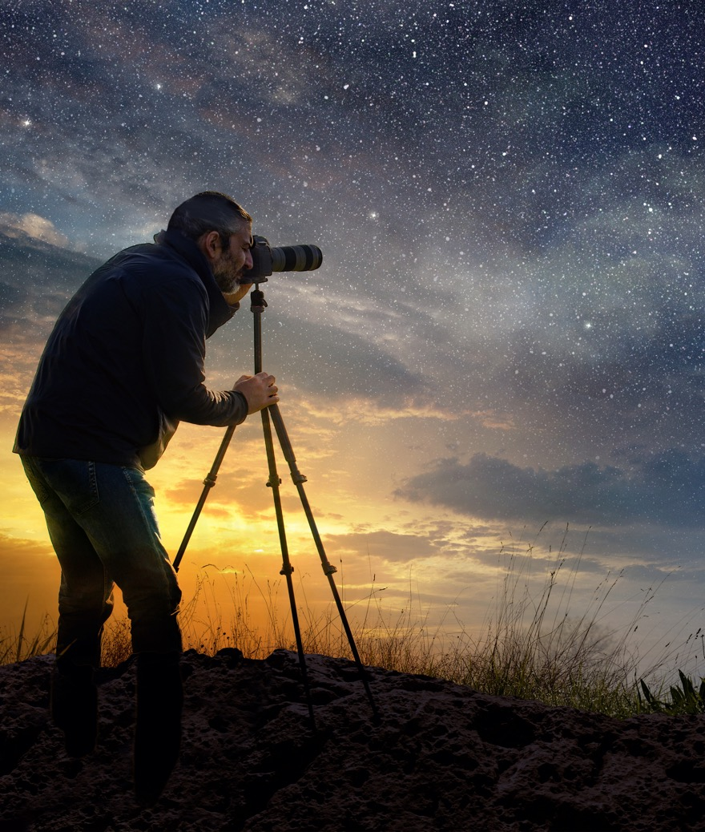
SECTION
01
Introduction

Slide 4
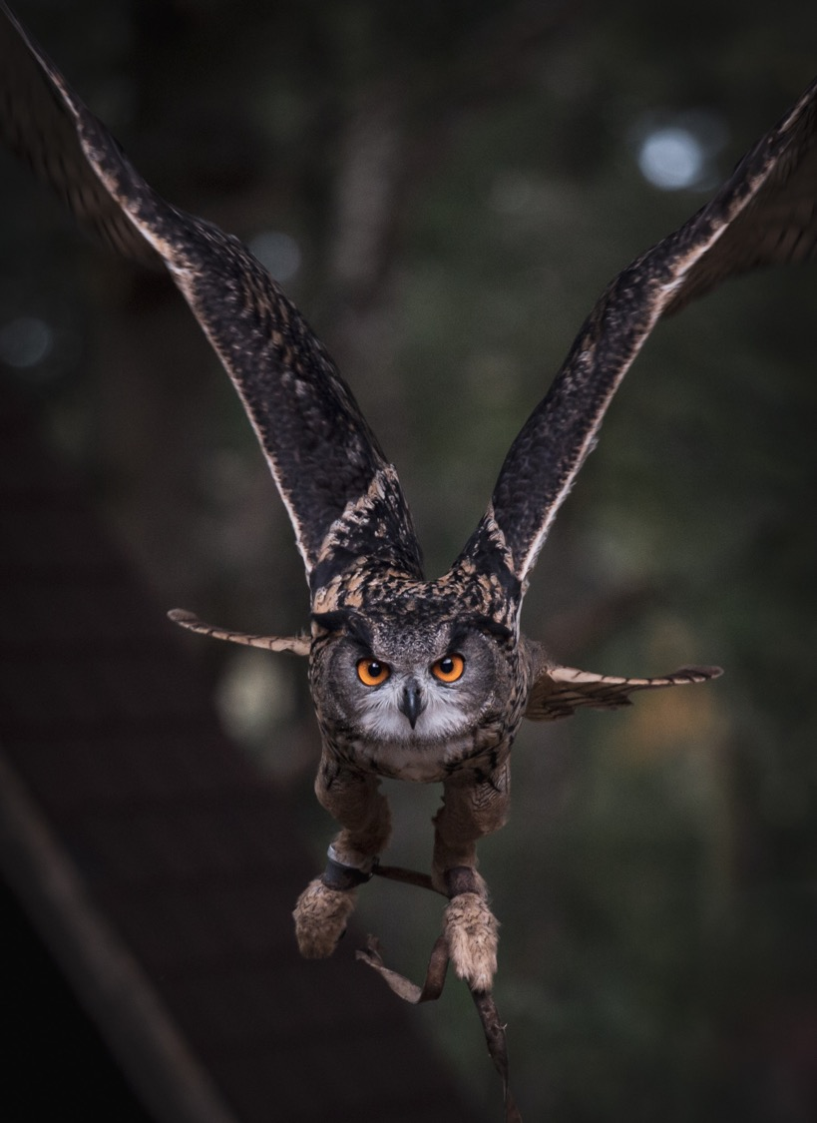
INTRODUCTION
Introduction to the Module includes:
Overview of the project
Overview of the aims
Modular Overview
4

Slide 5
What is the Dark Sky Ecotourism Project?
Our Dark Sky ecotourism project revolves around the shared heritage and culture that the stars and planets in the night sky have provided throughout human history. It serves as a poignant reminder that we all inhabit the same Earth and share a responsibility in safeguarding it.
In the present day, much of Europe grapples with the issue of light pollution, necessitating a deliberate search for destinations with minimal light interference to appreciate the celestial spectacle. Dark Sky Ecotourism emerges as a niche within the tourism sector, showing great potential for expansion. What sets our initiative apart is the seamless integration of both dark sky and ecotourism, viewing them as harmonious and cost-effective forms of tourism innovation that capitalise on two invaluable resources: the night sky and the natural world.

Slide 6
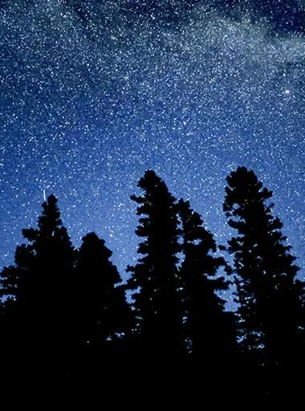
The Overall Aim
The overall aim of our set of modules on Dark Sky ecotourism is to educate and inspire individuals, particularly those in Europe who may not have been exposed to this concept, about the beauty and significance of preserving dark skies and natural environments. Our aim is to raise awareness about the importance of minimising light pollution and promoting sustainable tourism practices.
Through these modules, we intend to equip people with the knowledge and tools needed to appreciate the night sky's wonders and the natural world's richness while fostering a sense of responsibility for its protection. Ultimately, we aim to encourage the growth of Dark Sky Ecotourism as a sustainable and enriching form of tourism in Europe, harmonising the appreciation of the night sky and nature for both locals and visitors alike.

Slide 7
Quick Overview of the Modules
Module 1 – Within this module, we define and discuss the importance of Dark Sky Ecotourism, set the stage and introduce the upcoming modules.
Module 2 – This module sets the scene and helps the user to see the value in dark sky ecotourism. Whether you are a newcomer to dark sky ecotourism, or established, this module aims to help you discover the possibilities.
Module 3 – Here you learn about engaging your audience. It is important to understand the needs and wants of your customer base, here we help you brand and market your business towards your consumers and overall end goal.
Module 5 – Focuses on the ‘Message’ you want to come from your dark sky experience and the feeling you want to leave your audience with.
Module 4 – Within this module, you learn how to create your own dark sky ecotourism experience and how to manage the expectations of your audience.

Slide 8

SECTION
02
Learning Objectives

Slide 9
Within this module you will learn:
To define Dark Sky Ecotourism and explain its key principles and values
To develop a holistic understanding of the benefits, challenges, and potential of Dark Sky Ecotourism.
To recognise the impact of light pollution on ecosystems, wildlife, and health
To explore strategies to raise awareness and become ecotourism conscious in the context of Dark Sky preservation.
To analyse successful Dark Sky Ecotourism reserves and identify best practices for implementation

Slide 10
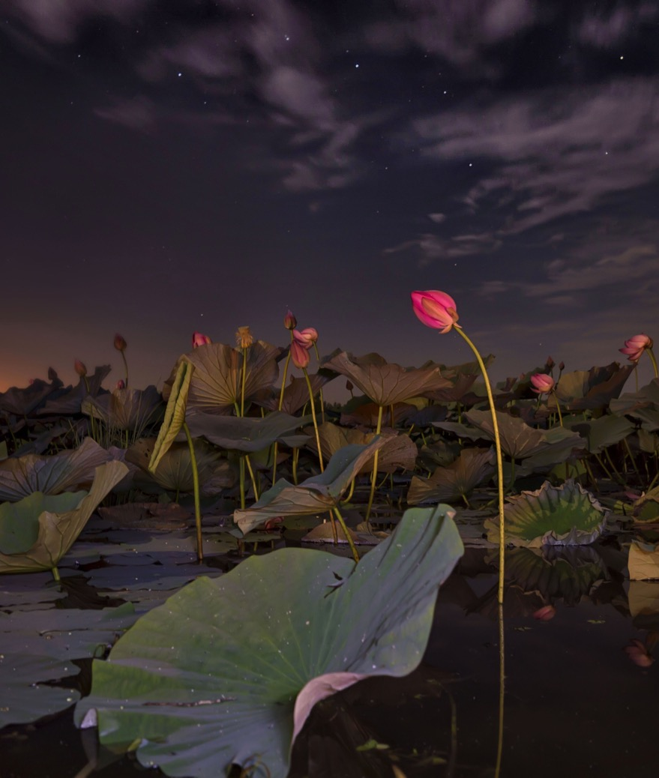
SECTION
03
What is Dark Sky Ecotourism?

Slide 11
Dark Sky Tourism
By creating a tourism product that uses the dark sky in an eco-friendly way you make a dark sky ecotourism product.
Dark Sky Ecotourism is the intersection of sustainable tourism and astronomy, promoting the appreciation of dark skies and minimising light pollution.
Dark Sky Ecotourism
Ecotourism

Slide 12
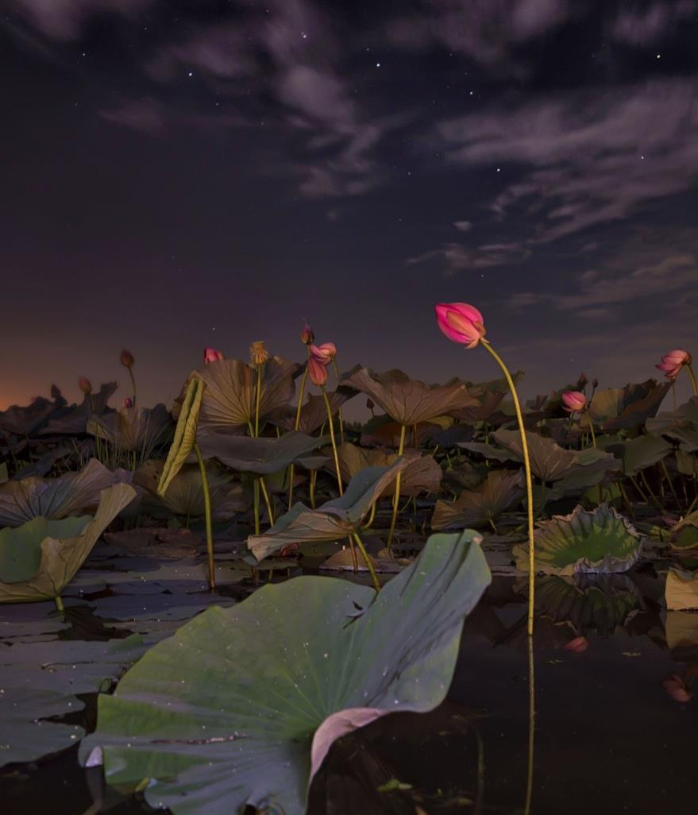
Dark Sky Tourism - Definition
Dark sky tourism is characterised by the fact that visitors travel to remote, unlit areas on land or water to observe phenomena on it. Examples of such objects are stars, planets, moons, nebulae, star clusters and galaxies.
Inspection can be done with a hand-held telescope, a star telescope or with the naked eye. Visitors' experience of a darkened sky can also be mixed with other subjects, such as star photography or listening to a storyteller (Dalgleish et al., 2022).

Slide 13
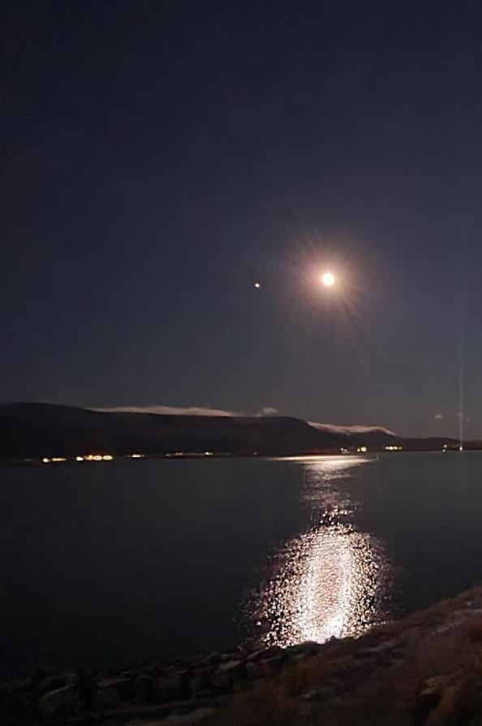
ECOTOURISM
“Travel with a primary interest in the natural history of a destination. It is a non-invasive and participatory form of nature-based tourism that is built around learning, sustainability (conservation and local participation/benefits), and ethical planning, development and management” (Fennell, 2020).

Slide 14
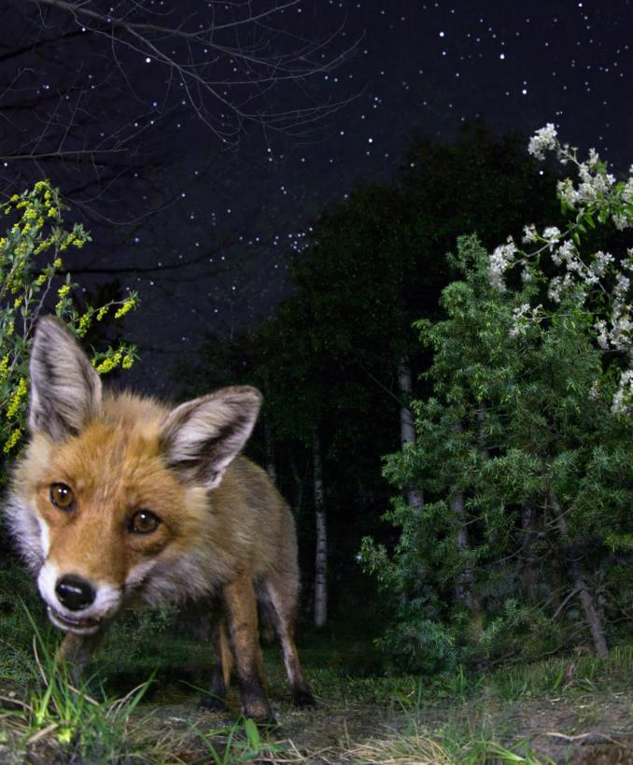
Dark Sky Ecotourism Definition
The motivation behind Dark Sky Ecotourism is to travel to areas with good dark quality to observe phenomena in the sky, e.g., auroras, space nebulae or stars.
The motivation may also be to experience the dark sky in another way, e.g., through astrophotography or through stories.
The travel product is designed with ethical planning, development and management in mind, includes learning and is guided by sustainability - contributes to the conservation of local nature and has a positive impact on local society (Elinardottir, 2023).

Slide 15
SECTION
04
Importance of Dark Sky Ecotourism

Slide 16
Pillars of Benefits
These four pillars are the foundation for understanding how dark sky ecotourism can benefit communities, companies and the ecosystem.
By breaking the benefits into these four aspects it should be easier to find out the benefits of dark sky ecotourism to your community, company and the nature around you.
DARK SKY TOURISM
ECOTOURISM
INNOVATION
RURAL TOURISM

Slide 17
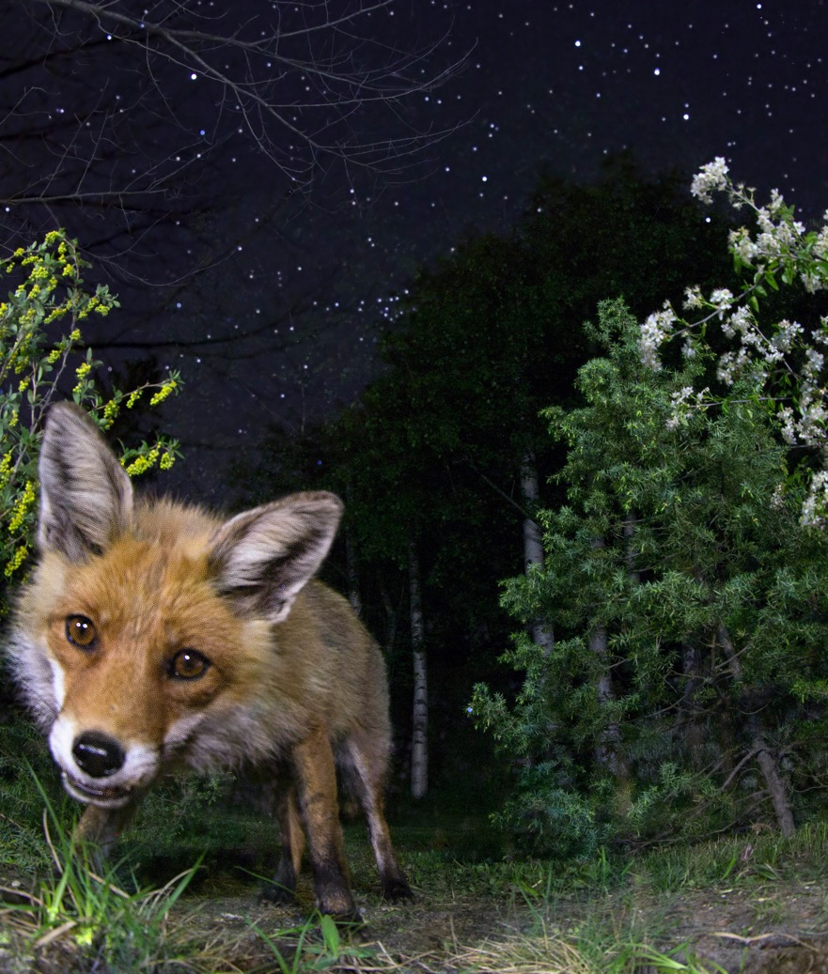
Pillars of Benefits – Ecotourism
Ecotourism is the foundational element of this model. It is the practice of travelling responsibly to natural areas to enjoy and appreciate nature, without harming it or disturbing local communities.
The aim here is not just leisure, but also education and conservation. By fostering responsible tourism practices, ecotourism helps preserve natural habitats and serves as a way to inform and educate visitors about the significance of ecological conservation.

Slide 18
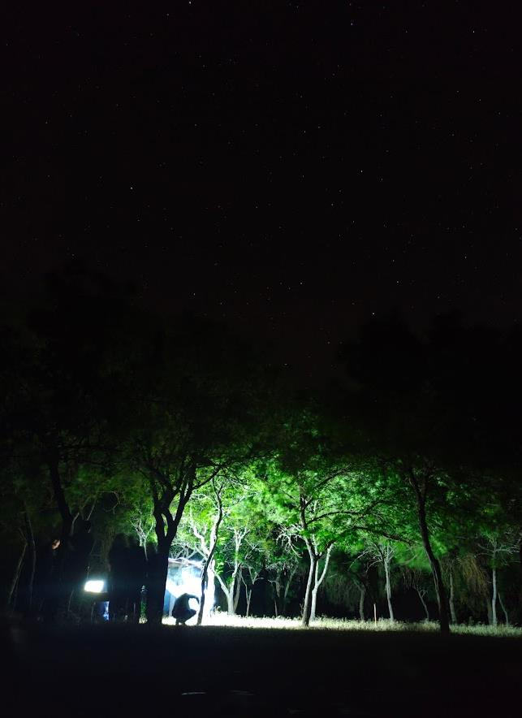
Pillars of Benefits – Dark Sky Tourism
Dark Sky tourism is a more focused form of ecotourism, often centered around specific geographic areas where light pollution is minimised or non-existent. This enables people to enjoy celestial events like meteor showers, star-gazing, and even simple moonlit walks.
Beyond the obvious appeal to astronomers and casual stargazers, dark sky tourism also supports the protection of nocturnal wildlife. Animals that rely on the natural rhythms of day and night benefit when their habitats are not disrupted by artificial lighting.

Slide 19
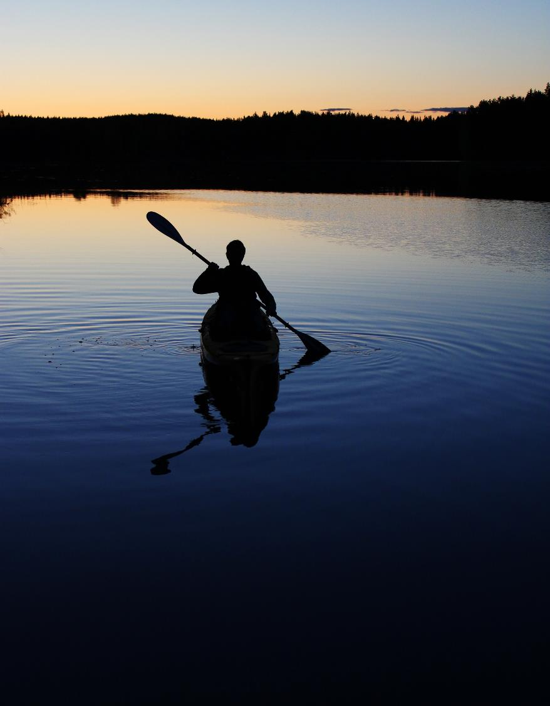
Pillars of Benefits – Rural Tourism
Rural Tourism is typically set in less populated areas and aims to give visitors an authentic experience of a region's culture, traditions, and landscapes. It often goes hand in hand with ecotourism and Dark Sky tourism, as rural areas provide the ideal setting for both.
Through rural tourism, small communities can diversify their economies and enrich their cultural heritage. Visitors not only boost the local economy but also gain a deeper understanding of a different way of life, which is often more in tune with nature.

Slide 20

Pillars of Benefits – Innovation
Innovation acts as the engine that drives improvements across all other pillars. This could involve the use of technology—like apps to identify constellations—or even new business models that make tourism more efficient and less harmful to the environment.
Innovation is not limited to gadgets or apps; it can also involve new approaches to marketing, customer engagement, and community involvement. By staying ahead of trends and adopting new methods, the pillars of Ecotourism, Dark Sky, and Rural Tourism become more appealing and effective.

Slide 21
Interconnectedness and Importance
The circular arrangement of the pillar of benefit diagram underscores how each pillar is linked and can positively influence the others. For instance, a technological innovation might make it easier for people to engage with ecotourism activities. This, in turn, could attract a broader audience who might also be interested in experiencing the rural or dark sky aspects.
The cyclical nature of the diagram suggests that continuous improvement in one area can lead to benefits across the board, creating a robust and effective tourism model.
Each pillar, while distinct, contributes to the larger goal of developing a holistic, interconnected approach to tourism that is both effective and responsible.
DARK SKY TOURISM
ECOTOURISM
INNOVATION
RURAL TOURISM

Slide 22
SECTION
05
Understanding Light Pollution

Slide 23
What is Light Pollution?
Light pollution can be defined as the excessive, misdirected, or obtrusive artificial light generated by human activities that disrupts the natural darkness of the night sky (Czarnecka, 2021). According to research by Viola et al., as cited by Czarnecka, this form of environmental pollution is most prevalent in city centres and intensifies with an increase in population density. The implication is that escaping light pollution is most feasible in areas far removed from human habitation.
This definition emphasises light pollution as not merely an aesthetic issue but one with ecological and human health implications.

Slide 24
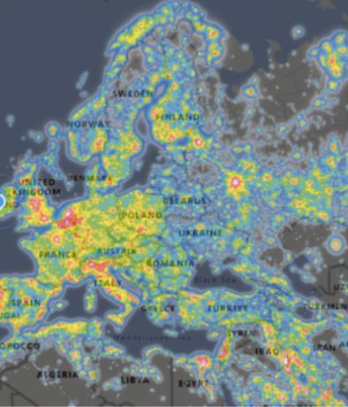
The Dangers of Light Pollution
Though often relegated to the background in discussions of environmental pollution, the implications of light pollution are wide-ranging and multi-dimensional.
These range from ecological disturbances affecting wildlife to adverse impacts on human health, significant energy waste, challenges to astronomical research, economic consequences, and even the loss of cultural heritage.
The following discussion aims to provide a comprehensive and detailed examination of each of these dangers to illuminate the urgent need for addressing this often-overlooked form of pollution

Slide 25
Ecological Impact
The adverse effects of light pollution on nocturnal animals and ecosystems are well-documented. For instance, nocturnal birds that use the moon and stars for navigation become easily disorientated in the presence of bright, artificial lighting.
This disorientation can lead to fatal collisions with buildings, trees and other structures. This issue is of such concern that it has led to dedicated research into what is termed “ecological light pollution”, underscoring the threat it poses to biodiversity. (Longcore and Rich, 2004)

Slide 26
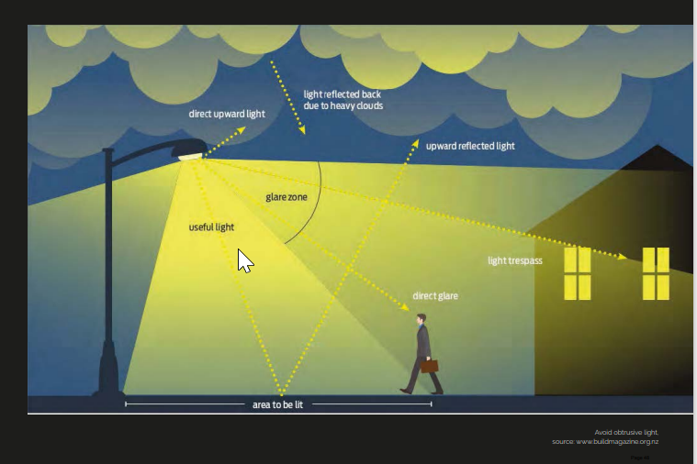

Human Health
Human health is not immune to the consequence of light pollution. The disruption of natural circadian rhythms due to excessive exposure to artificial light at night is a serious concern.
Circadian rhythms help regulate sleep, feeding, hormone production and cellular repair, among other bodily functions.
A disrupted circadian rhythm has been linked to sleep disorders, depression and an elevated risk of chronic conditions like obesity and diabetes. (Chepesiuk, 2009)

Slide 27
Energy Waste
Light pollution also has ramifications in terms of energy consumption. Poorly designed outdoor lighting systems, which scatter light instead of directing it where it is needed, contribute to unnecessary energy waste. This is not just an economic concern but also has environmental implications, as excess energy production often leads to increased greenhouse gas emissions, contributing to climate change (Gallaway et al., 2010).

Slide 28
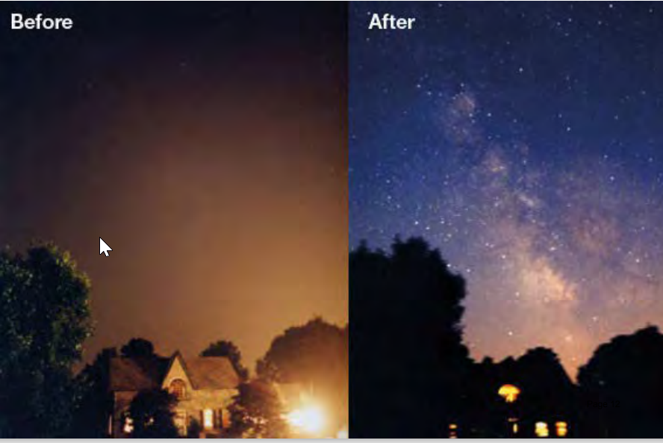
Astronomical Research
From a scientific perspective, light pollution severely hampers astronomical research.
The light emitted from artificial sources washes out the visibility of celestial objects in the sky, thus making it increasingly difficult for telescopes and other observational instruments to capture detailed images or data.
This impairs scientific investigations into various celestial phenomena and limits our understanding of the universe (Cinzano et al., 2001).

Slide 29
Loss of Cultural Heritage
It's worth considering light pollution as a loss of cultural and natural heritage. Over the course of history, humanity has relied on the night sky for navigation, timekeeping, and even spiritual or philosophical insight.
The over-illumination of the night sky robs future generations of this natural resource, altering the relationship humans have with their universe and depriving them of a crucial aspect of their heritage (Kyba et al., 2017).

Slide 30
Economic Impact
While not a danger in the traditional sense, the economic consequences of light pollution are significant.
Areas plagued by light pollution may struggle to attract tourism related to stargazing or other night-time activities.
The resulting loss of income can be substantial and have broader economic repercussions for those communities (Bogard, 2013).

Slide 31
Overview of EU Policy on Light Pollution
According to the United Nations' Food and Agriculture Organisation (FAO), biodiversity and ecosystems significantly influence the world economy. European countries are taking steps to protect dark skies by limiting light pollution, which not only saves energy but also protects flora and fauna. These regulations enable the growth of astrotourism and experiential tourism, contributing positively to communities. The EU's Green Public Procurement (GPP) criteria address environmental impacts of road lighting, including energy consumption and light pollution. The EU is also committed to promoting sustainable tourism as part of its European Green Deal, aiming for a balanced economic recovery that respects environmental and cultural resources. The tourism sector has a key role to play in meeting sustainability goals, as discussed at international forums like the FITUR fair in Madrid.
For more in-depth research on this, please refer to page 61 of our Dark Sky Ecotourism Guide - https://darkskytourism.eu/dark-sky-ecotourism-guide/

Slide 32
SECTION
06
Becoming Ecotourism Aware

Slide 33
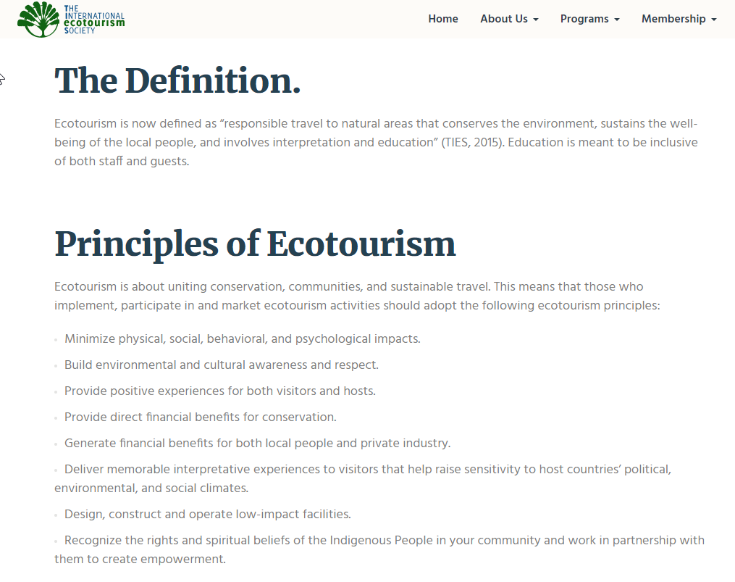
Becoming ecotourism aware
To explore the opportunities that Dark Sky Ecotourism can offer the first step for a tourism business is to find out how your business is doing in regards to principle of ecotourism.
The dark sky ecotourism project has created a self-assessment quiz that is designed to help tourism businesses to self-evaluate their current innovation capacity and “readiness” to make the most of ecotourism opportunities.
This quiz is based on the eight principles of ecotourism set forth by the International Ecotourism Society, see. https://ecotourism.org/what-is-ecotourism/
Source: https://ecotourism.org/what-is-ecotourism/

Slide 34

Becoming ecotourism aware
Your business or community might already be active in the area of ecotourism or you might need to learn a little more about ecotourism before you feel ready to innovate in this area. Whatever your starting point, this simple quiz will help point you in the direction you need to go next.
At the end of the quiz, you will receive an ecotourism innovation-ready score along with a short report summary which suggests areas for further learning.
Check these tools on the dark sky ecotourism website: https://darkskytourism.eu/self-assessment-and-toolkit/

Slide 35


The European Commission support for the production of this publication does not
constitute an endorsement of the contents which reflects the views only of the authors,
and the Commission cannot be held responsible for any use which may be made of the
information contained therein.

Slide 36
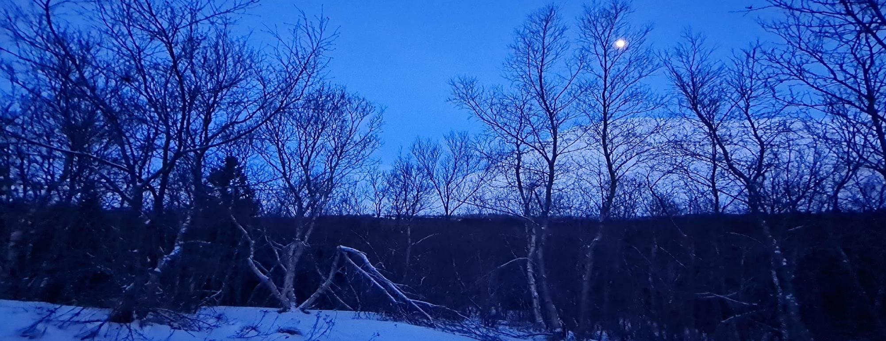

Follow our journey here
www.darkskytourism.eu

