Slide 1
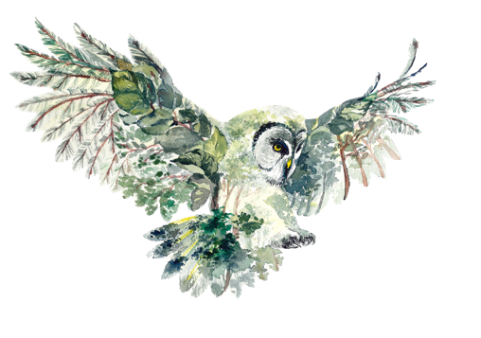
DARK SKY ECOTOURISM
MODULE 2
Setting the Scene
www.darkskytourism.eu
Dark Sky Ecotourism VET Programme © 2023 by Dark Sky Ecotourism Consortium is licensed under CC BY-SA 4.0
Funded by the European Union. Views and opinions expressed are however those of the author(s) only and do not necessarily reflect those of the European Union or the European Education and Culture Executive Agency (EACEA). Neither the European Union nor EACEA can be held responsible for them.

Slide 2
Learning objectives for module 2
This module sets the scene and helps the user see the value in dark sky ecotourism. Whether you are a newcomer to dark sky ecotourism, or established, this module aims to help you discover the possibilities.

Slide 3
TABLE OF CONTENTS
Mapping the dark sky conditions in your region
01
02
Learning & sharing info about your local natural ecosystem
03
Finding the stars
04
Useful equipment for dark sky ecotourism experiences
05
Risk assessment

Slide 4
SECTION
01
Mapping The Dark Sky Conditions In Your Region

Slide 5
INTRODUCTION
Module 2 introduces several aspects to keep in mind when starting or developing a dark sky ecotourism activity.
It is aimed at helping the newcomer to the field to orientate and to see the value in dark sky ecotourism.
Depending on your business (or a community) we introduce several different aspects for you to focus on
5

Slide 6
Are you already in/ near a Dark Sky destination?
First you can check if you are already located close to a dark sky recognised destination on one of these websites. There are many great sites all over Europe.
https://www.darksky.org/
https://en.fundacionstarlight.org/
If you are located close enough to one of these destinations, you are probably able to offer dark sky tourism experiences.
However, even if you are not located in one of these areas you may still be able to bring your tourists to the sites if it is not too far.
Learning activity: Find out if you are already close to a dark sky recognized destination, check the links above.

Slide 7
Seeing the potential of a dark sky ecotourism in your area
If your area has good night sky potential, why not start a local group to develop the opportunities for your business and partners in the area?
This could be really simple – e.g. you could start a Facebook/ other social media group to allow people to share ideas, expertise, photography and destination promotion.
As you learn more about the potential you may become interested in related topics such as local night-time history and folklore, light pollution, astrophotography, ecology and local flora and fauna
If the quality of the sky locally is good you can then start to utilise our Dark Sky Ecotourism resources to learn some bite sized tips related to potential activities.

Slide 8
Assessing local levels of light pollution
There are many mobile applications you can use to grade light pollution. These include using a scale called the Bortle Scale and also various dark sky meters.
You can download an application on your phone and we have listed some sample ones on the next page.
Simply point your phone at the night sky to see the quality of star gazing opportunities available in your area.

Slide 9
The Bortle Scale
The Bortle Scale is one mechanism to grade the levels of light pollution in the sky. The scale has nine categories, ranging from excellent dark sky site to inner city sky. These are listed below:
Excellent dark sky site
Typical truly dark sky site
Rural sky
Rural/ suburban transition
Suburban sky
Bright suburban sky
Suburban/ urban transition
City sky
Inner city sky
Learning activity:
Find out about your region regarding light pollution and the quality of the dark sky. Use the light pollution map, dark sky meter and/or the Bortle scale websites, see useful links on slide 12.

Slide 10
How can I get involved?
First you need to assess local or regional night sky quality and identify if there is a suitable location with low levels of light pollution
This can be a very straightforward exercise and you do not need any technical skills to do it.
There are websites, applications, maps, and guides to help you.
You may also wish to purchase some (very inexpensive) technology to develop the opportunity.

Slide 11
If you are in/ near a Dark Sky destination
You may be able to access support/ training from your region. This training could be on business supports, technical knowledge such as ecology, astrophotography or ecotourism principles.
You may be able to join a local network of similar businesses. Dark sky ecotourism will work best when businesses partner together and share knowledge and tips.
You can learn from local experts (e.g. ecologists, astronomers, photographers) and you may be able to access expertise to support delivery of tours and experiences

Slide 12
Dark Sky Ecotourism – resources available to you
to use to check out the dark scale quality in your area.
Light Pollution Map
https://play.google.com/store/apps/details?id=com.pa.lightpollutionmap&hl=en&gl=US
Dark Sky Meter
https://www.darkskymeter.com/
Loss of the Night citizen science project
https://lossofthenight.blogspot.com/
The Bortle Scale
https://astrobackyard.com/the-bortle-scale/

Slide 13
SECTION
02
Learning & sharing info about your local natural ecosystem

Slide 14
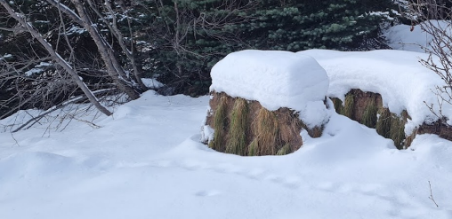
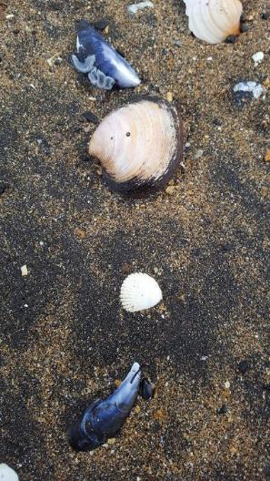
– Using methods of nature interpretation
For this activity we apply the methods of nature interpretation to create a well-defined theme or topic that leads visitors throughout the walk and introduces the dark sky, its creatures, ecosystem and value in an interesting way. We use Freeman Tilden´s 6 principle of environmental interpretation:
Interpretation that does not somehow relate what is being displayed or described to something within the personality or experience of the visitor will be sterile. Interpretation should be personal to the audience.
Information, as such, is not interpretation. Interpretation is revelation based upon information. Successful interpretation must do more than present facts.
Interpretation is an art, which combines many arts. Any art is in some degree teachable.
The chief aim of interpretation is not instruction, but provocation. Interpretation should stimulate people into a form of action.
Interpretation should aim to present a whole rather than a part. Interpretation is conceptual and should explain the relationships between things.
Interpretation addressed to children should not be a dilution of the presentation to adults, but should follow a fundamentally different approach. Different age groups have different needs and require different interpretive programs.
(Tilden, F. 1977. Interpreting Our Heritage. 3rd edition. Chapel Hill: The University of North Carolina Press.)
Source: https://mylearning.nps.gov/library-resources/tildens-six-principles-ace/
14

Slide 15
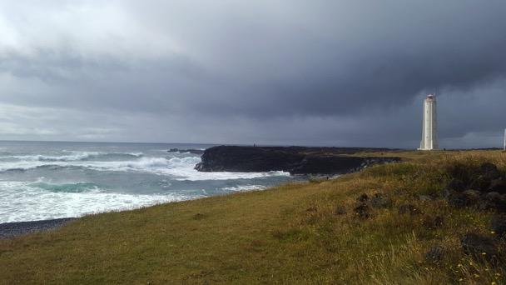
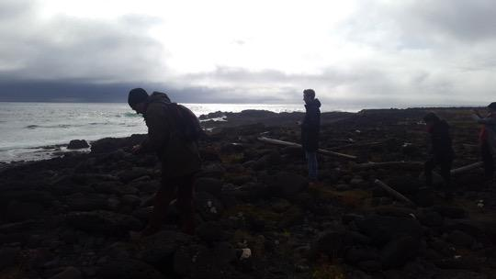
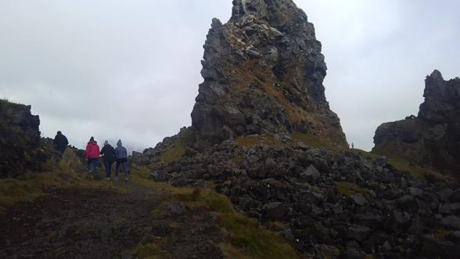
Use the 3 steps of experience design
Step 1
Breath!
It is important to know how your guest is likely to experience your dark sky ecotourism experience. Product development is a process where the many aspects of the travel product can be analysed. One way to review and strengthen your experience is to look at the following three steps from the eyes of the guest:
Step 1 - Anticipation before the tour begins – how do I present my experience? What images/videos do I use? What words?
Step 2 - The experience itself – does the guest get what was promised? Can I exceed those expectations? How do I do that?
Step 3 - Memories after the experience - what are my interactions with guests at the end of the tour and when they return home? Did I send them e.g. an email and tell them what I offer in other seasons? Do I send a thank you note that mentions other travel products?
Breath in the power of nature!
Step 2
Tell a memorable story
Give your guest the opportunity to listen, calmly enjoy, taste etc. ...
Step 3
We thank you for the visit ...choose a picture that e.g. shows your area in a different seaon
15

Slide 16
How to I accurately and ethically create anticipation
for my dark sky walk?
Keep in mind what your guest anticipation before the tour begins – how do I present my tourism product? So you need to ask yourself what pictures, videos and words do I use?
As part of an ecotourism standard any marketing material you use should support your sustainability and ecotourism policy. This means that e.g. pictures and videos of the tourism product you are selling should give a fair depiction of what a tourist can expect and should not show any tourist activity that might endanger the local ecosystem, flora or fauna. This also applies to the local community.
E.g. One does not always see the stars clearly, it can be cloudy. The weather can have an impact; too windy; too cold etc:
Learning activity: use an example from an existing dark sky ecotourism activity. Let people read a short description and then have e.g. 5 pictures to choose from that they feel reflectes the ecotourism aspect.
16

Slide 17
Dark Sky Activities – engaging your visitors
You can do offer many tourist activities under the night sky which are educational, experiential and often co-created. Whatever the activity, you should try and educate and engage tourists with local ecology and the value of the night sky to flora and fauna. You could for example offer:
A physical night time activity such as a night safari, night time kayaking, wild camping
Astronomy related experiences such as viewing celestial events, the Northern Lights or well known stars and constellations
You may be able to offer experiences related to night time culture and heritage, such as story-telling, myths, folklore, heritage and history of astronomy
You may be able to offer something related to health such as night time yoga, meditation, breathing or a detox from the city for urban visitors

Slide 18
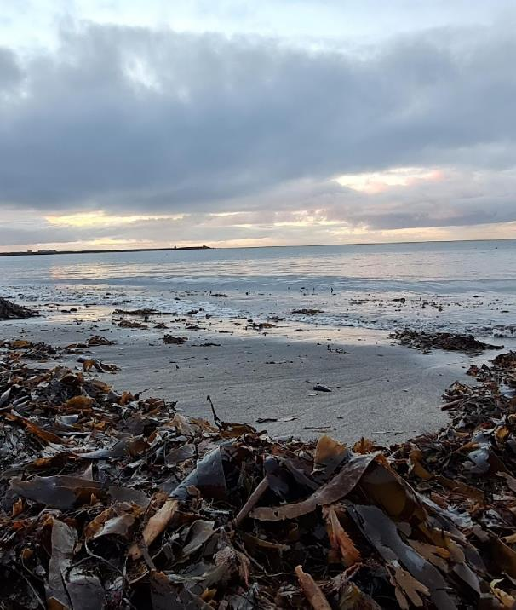
After the experience - a dark sky ecotourism message
Here we apply the method of nature interpretation to connect our guests to nature at our specific activity site and in general. Module 5 gives you more insights into creating an ecotourism message
Your ecotourism message - step 3 in your experience design
What do you want to say?
How can I say it without words, i.e. as part of the experience throughout the walk?
How can my ecotourism message affect the behavior of my guests?
Impact of ecotourism message on the customer satisfaction
Beach near Reykjavík, Iceland
What do I see, smell, hear etc. (what senses are affected?
What can I interpret (through words, looking. Listening, smelling etc.) that will connect my guests to this place and in general to the wonders of nature?
Picture: Kjartan Bollason

Slide 19
Learning activity
Creating an ecotourism message:
Take a walk in your area and consider what is the ecotourism message that you want to send out to your guests and how do you tell that story. Keep in mind using all your senses.
Observe with all your senses and how can you use the information you obtain using this method.
Next bring a friend along and question what do they observe.

Slide 20
SECTION
03
Finding the stars

Slide 21
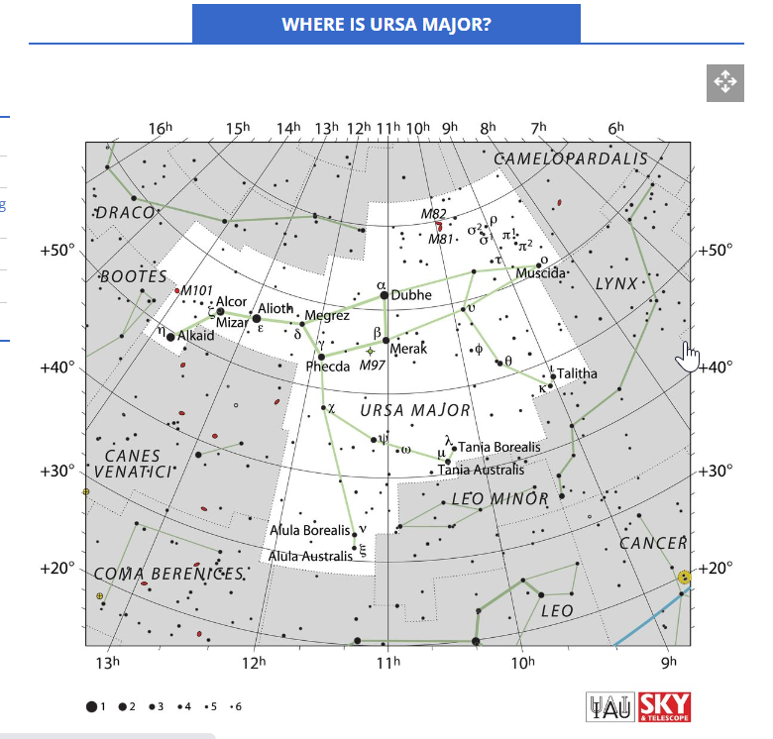
Finding the stars
One of the easiest pattern of stars to find in the Northern Hemisphere is the Big dipper/Plough (ice. Karlsvagninn) located in the constellation of Ursa Major
When you find the Big Dipper/Plough (marked red) you can use it to find other stars – such as the Pole Star – and other well known star pattern and constellations in the northern sky. It is therefore a good idea to located this constellation first.
Here is a video that shows you how to locate the Big Dipper/Plough:
Source:
https://www.youtube.com/watch?v=grAOh38clHI
Learning activity: Finding the stars – find the big dipper, watch a video and go outside.
Source: https://www.space.com/ursa-major-constellation-great-bear

Slide 22
Guide Training
Train guides to provide insightful commentary, blending scientific knowledge with engaging storytelling.
Cultural Narratives
Integrate cultural and historical narratives into the tour, sharing stories about islands, lighthouses, and local traditions.

Slide 23
SECTION
04
Useful equipment for dark sky ecotourism experiences

Slide 24
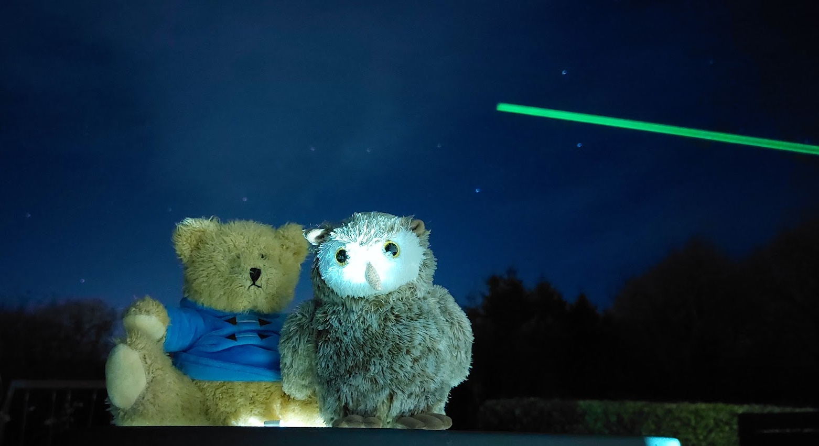
A Laser Pointer
A laser pointer can be a helpful tool for stargazing, particularly when you want to point out specific celestial objects to others.

Slide 25
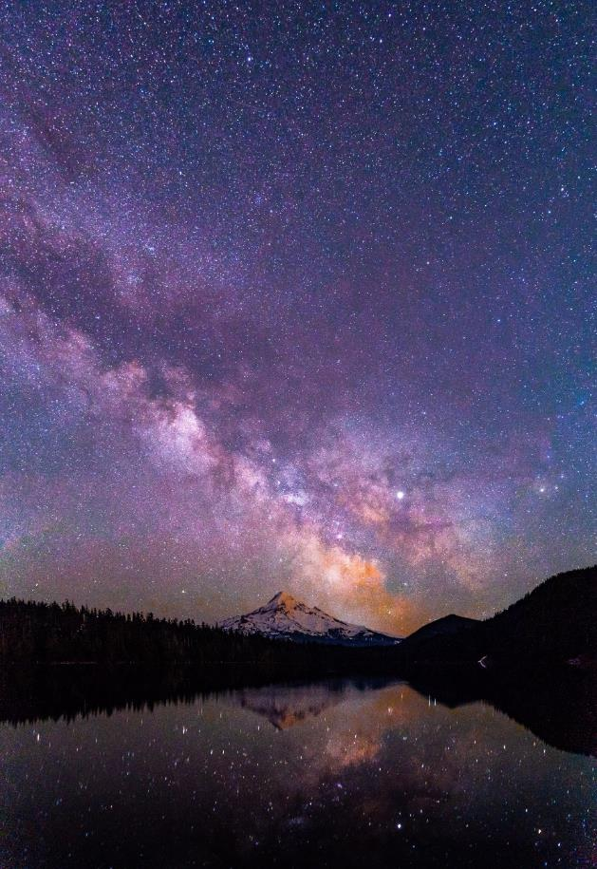
Here's how to use a laser pointer effectively:
Choose the right laser pointer: For stargazing, it's essential to use a green laser pointer with an output power of 5 milliwatts (mW) or less. Green lasers are visible at night and have a low enough power output to avoid any potential harm to the eyes.
Check local laws and regulations: Some areas have restrictions on laser pointer usage, especially near airports and military installations. Make sure to follow any applicable rules in your area.
Learn the night sky: Familiarise yourself with the constellations and specific celestial objects you want to point out. Apps and star charts can be helpful in learning the positions of various stars, planets, and other objects.

Slide 26
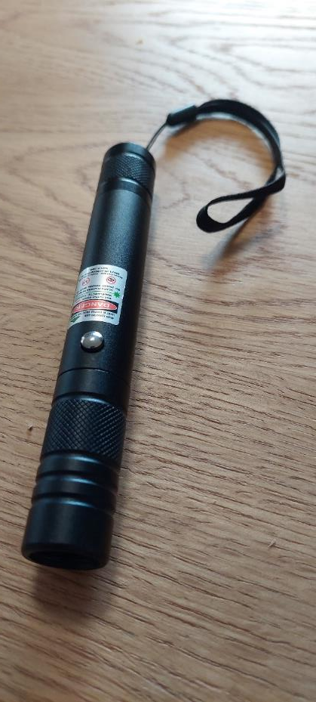
Here's how to use a laser pointer effectively:
Safety first: Never point the laser pointer directly at people, animals, or moving vehicles, including planes. Also, avoid looking directly into the laser beam, as it can be harmful to the eyes.
Pointing out celestial objects: When you have identified the object you want to show, turn on the laser pointer and direct the beam toward the object. The beam will create a visible line that appears to extend from your hand to the celestial object, making it easy for others to follow.
Keep it brief: Only use the laser pointer for a short period to avoid disturbing others or attracting unwanted attention. It's also essential to conserve battery life, as the laser can drain power quickly.
Educate others: If you're using a laser pointer to teach or guide others in stargazing, make sure they understand the importance of laser safety and proper usage.
Learning activity:
Follow the above steps and learn to use a laserpointer effectively

Slide 27
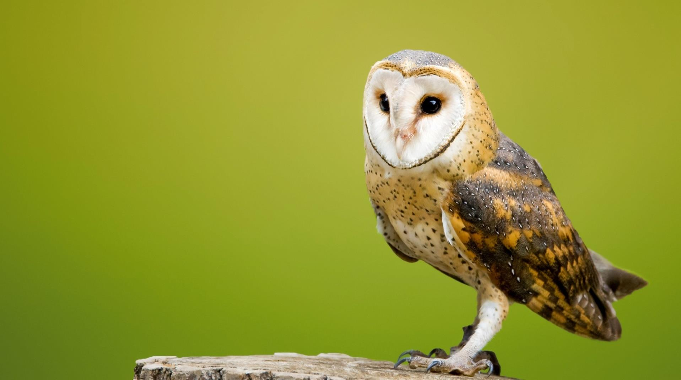
A night vision camera
A night vision camera can be an excellent tool for educational viewing of wildlife, particularly for observing nocturnal animals that are active during the night.

Slide 28
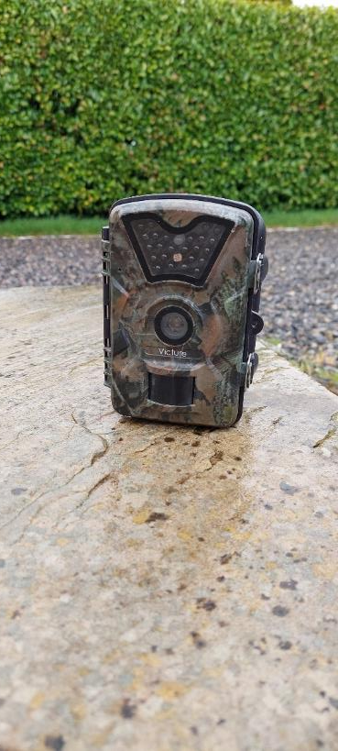
Here's how to use a night vision camera effectively:
Choose the right camera: Select a night vision camera suitable for your needs and budget. Options include trail cameras, camcorders with night vision capabilities, and dedicated night vision monocular or binoculars.
Learn about the camera: Familiarize yourself with the camera's features and settings, including its night vision capabilities, resolution, detection range, and any additional functionalities such as infrared illumination, motion detection, or time-lapse recording.
Select a location: Choose an area where you're likely to observe the desired wildlife. Consider factors such as the animals' natural habitats, the presence of food or water sources, and any visible signs of animal activity, such as tracks or nesting areas.
Set up the camera: Securely mount the camera on a tripod or attach it to a tree or other stable structure, ensuring it's pointing toward the area of interest. Position the camera to minimize interference from artificial light sources or obstructions.

Slide 29
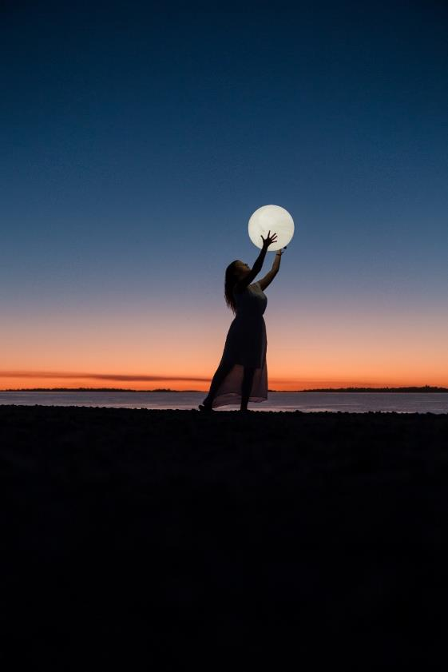
Here's how to use a night vision camera effectively:
Test the camera: Conduct a test run during the daytime to ensure the camera is functioning properly and capturing images or video as expected. Review the footage to confirm that the camera is focused and positioned correctly.
Observe animals at night: Use the night vision camera to observe wildlife during their most active periods, which often occur at dawn, dusk, or throughout the night for nocturnal species.
Record footage: Capture images or video of the animals for later review, analysis, or sharing. High-quality footage can be valuable for educational purposes, such as presentations or documentaries.

Slide 30
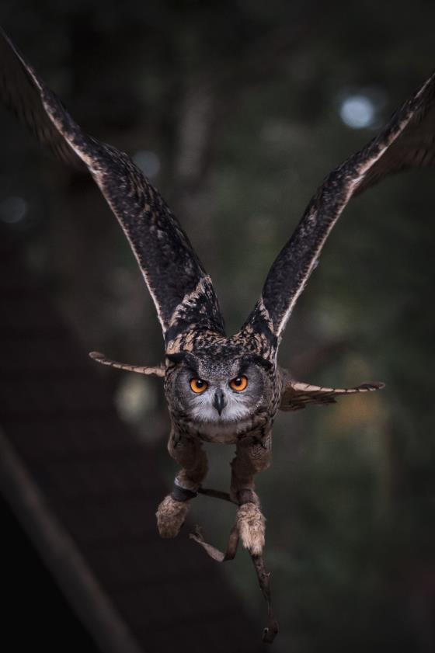
Here's how to use a night vision camera effectively:
Monitor and adjust: Regularly check the camera and its settings, adjusting as needed to improve image quality or capture specific behaviours.
Respect wildlife: When observing animals, maintain a safe distance to minimize disturbance and avoid interfering with their natural behaviours. Be mindful of local regulations and guidelines regarding wildlife observation and photography.
Analyse and share your findings: Review your recorded footage to learn more about the animals' behaviours, movements, and interactions. Share your findings with others, such as classmates, teachers, or wildlife enthusiasts, to promote a greater understanding and appreciation of the natural world.

Slide 31
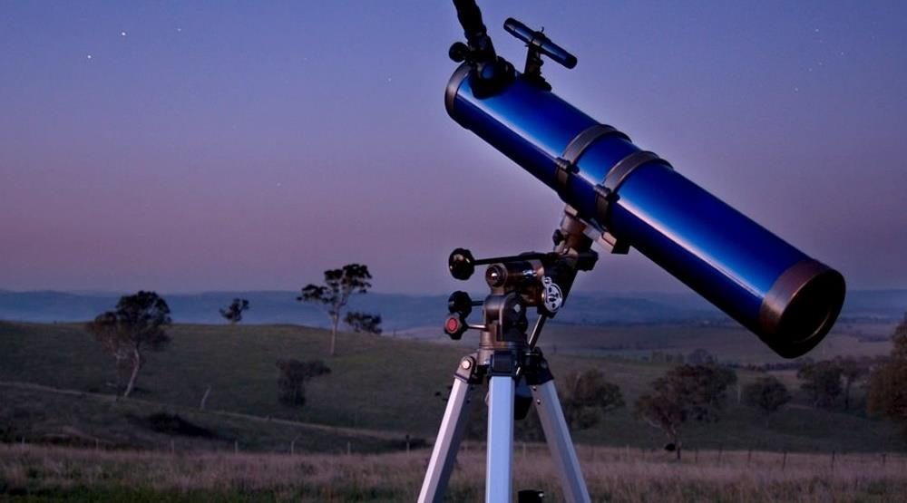
A telescope
Using a telescope for stargazing can greatly enhance your experience, allowing you to observe celestial objects in more detail

Slide 32
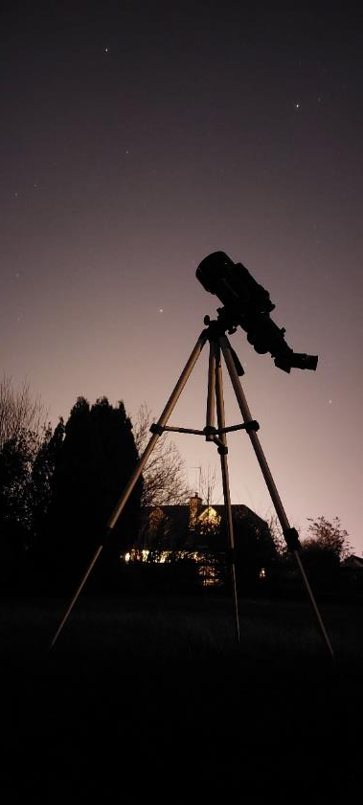
Here's how to use a telescope effectively:
Choose the right telescope: Select a telescope suitable for your needs and budget. Common types include refracting, reflecting, and compound telescopes. A good beginner telescope should have at least 70mm to 100mm aperture and a sturdy mount.
Learn the basics: Familiarize yourself with the telescope's components and how they work together. Key parts include the objective lens or mirror, eyepiece, mount, and finder scope.
Set up the telescope: Assemble the telescope and mount according to the manufacturer's instructions. Ensure the telescope is stable and secure on a flat surface, preferably away from city lights and other sources of light pollution.

Slide 33
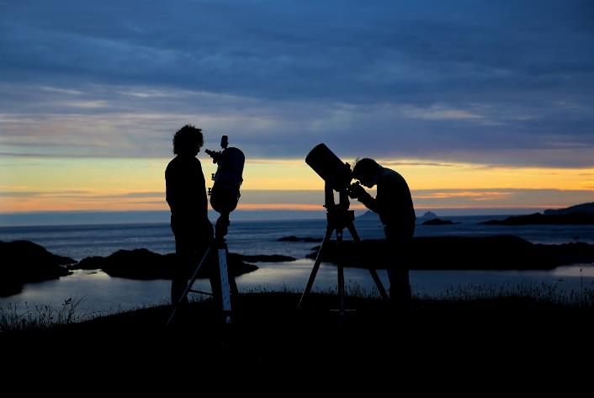
Here's how to use a telescope effectively:
Align the finder scope: During the daytime, point your telescope at a distant object (e.g., a tree or building). Look through the finder scope and adjust its alignment until the object is centered in both the finder scope and the main telescope's eyepiece.
Learn the night sky: Use star charts, apps, or a planisphere to familiarize yourself with constellations and celestial objects visible at your location and time of year.
Choose your targets: Start with bright objects that are easier to locate, such as the Moon, planets, and bright stars. As you become more comfortable with your telescope, you can move on to more challenging targets like galaxies, star clusters, and nebulae.
Locate the celestial object: Using your knowledge of the night sky and the aligned finder scope, point the telescope at the desired celestial object. Make sure the object is centered in the finder scope before

Slide 34
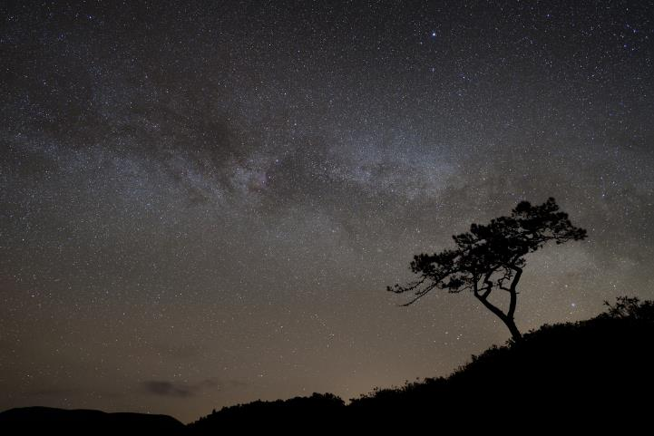
Here's how to use a telescope effectively:
Focus the image: Adjust the focus knob until the image appears sharp and clear in the eyepiece. You may need to refocus if you change eyepieces or observe different objects.
Swap eyepieces: To observe objects at different magnifications, switch between eyepieces with different focal lengths. Lower magnification eyepieces (with higher focal length numbers) provide a wider field of view, while higher magnification eyepieces (with lower focal length numbers) offer more detail but a narrower field of view.
Track the object: As Earth rotates, celestial objects will appear to move across the sky. If your telescope mount has a manual slow-motion control or an equatorial mount, use it to follow the object. Some motorized mounts can track objects automatically.

Slide 35
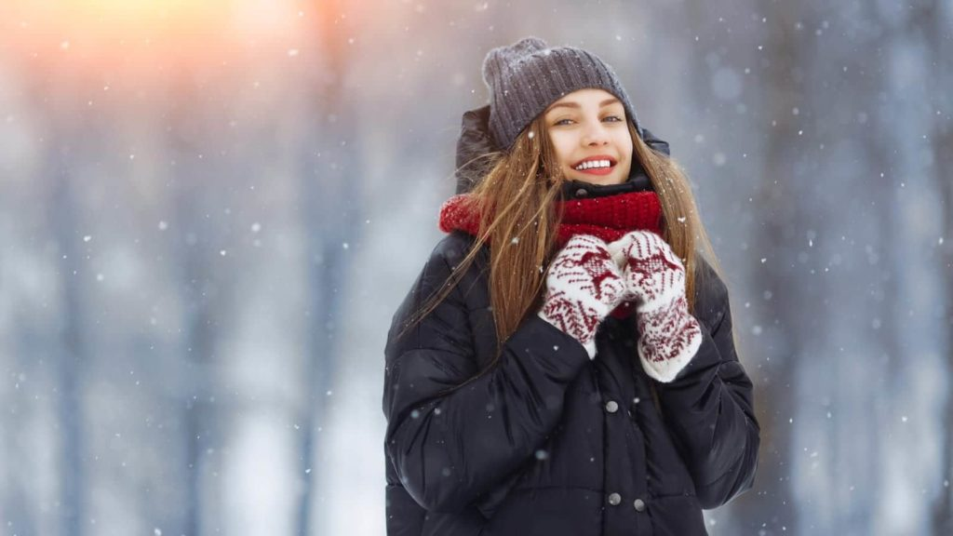
Warm clothes
Warm clothes are essential for stargazing.

Slide 36
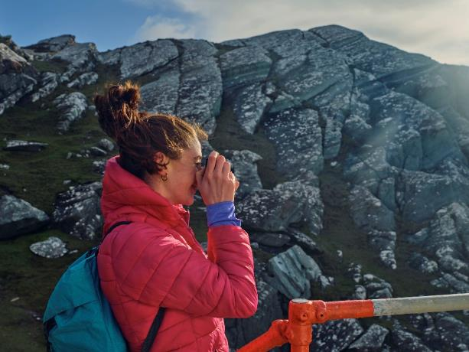
Warm clothes
Comfort: Stargazing often involves spending extended periods outdoors at night, when temperatures are typically cooler. Wearing warm clothes helps to keep you comfortable and allows you to focus on enjoying the night sky rather than feeling cold.
Temperature regulation: When you're outside for an extended period, your body may struggle to maintain its core temperature, especially if you're mostly stationary. Warm clothing helps to insulate your body and retain heat, preventing excessive heat loss.
Protection against hypothermia: Prolonged exposure to cold temperatures can lead to hypothermia, a dangerous condition in which your body's core temperature drops below normal levels. Wearing appropriate warm clothing can reduce the risk of hypothermia.

Slide 37
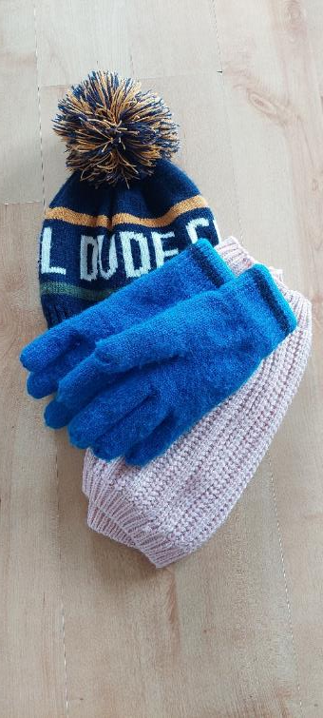
Warm clothes
Improved concentration: Being cold can make it difficult to concentrate on observing the night sky, as you may become preoccupied with trying to stay warm. Dressing warmly helps to minimize distractions and allows you to focus on stargazing.
Extended viewing time: Wearing warm clothes enables you to spend more time outside observing the night sky without becoming too uncomfortable. This can be particularly important for viewing events that may take a long time to unfold, such as meteor showers or eclipses.
Equipment protection: Cold temperatures can cause some electronic devices, such as cameras or smartphones, to malfunction or lose battery life more quickly. Wearing warm clothes helps to keep you warm, which in turn can help you to keep your equipment warm and functioning properly.

Slide 38
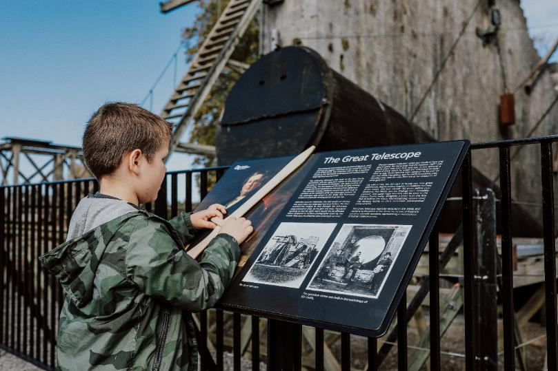
Warm clothes
Insulating layers: Start with a moisture-wicking base layer to help keep sweat away from your skin, followed by insulating layers like fleece or down jackets.
Windproof and waterproof outer layers: These can help protect you from the elements, such as wind or light rain.
Warm headwear: A hat or beanie helps to minimize heat loss through the head.
Gloves or mittens: These protect your hands from the cold and make it easier to handle equipment.
Warm socks and footwear: Insulated socks and shoes help to keep your feet warm and comfortable.

Slide 39
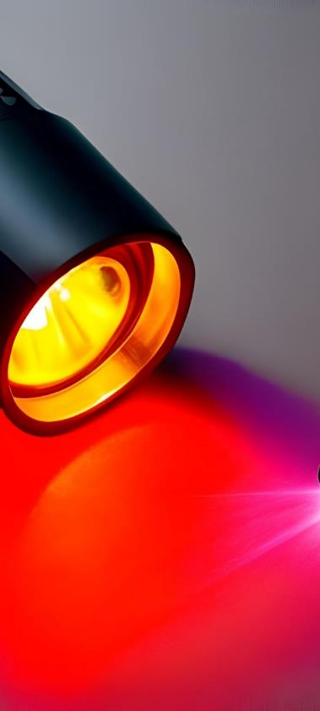
Red flashlight
Preserve night vision: Our eyes take time to adjust to the darkness, a process called dark adaptation. This process allows our eyes to become more sensitive to faint light sources, like stars and other celestial objects. White light can easily disrupt this adaptation, causing your eyes to lose sensitivity and making it harder to see faint objects. Red light, on the other hand, has a minimal impact on night vision, allowing you to maintain your eyes' sensitivity to dim light.
Minimize disturbance: Using a red flashlight during group stargazing events or at public observation sites helps minimize disturbance to other observers. As it doesn't affect night vision as much as white light, it ensures that everyone's stargazing experience remains enjoyable.

Slide 40
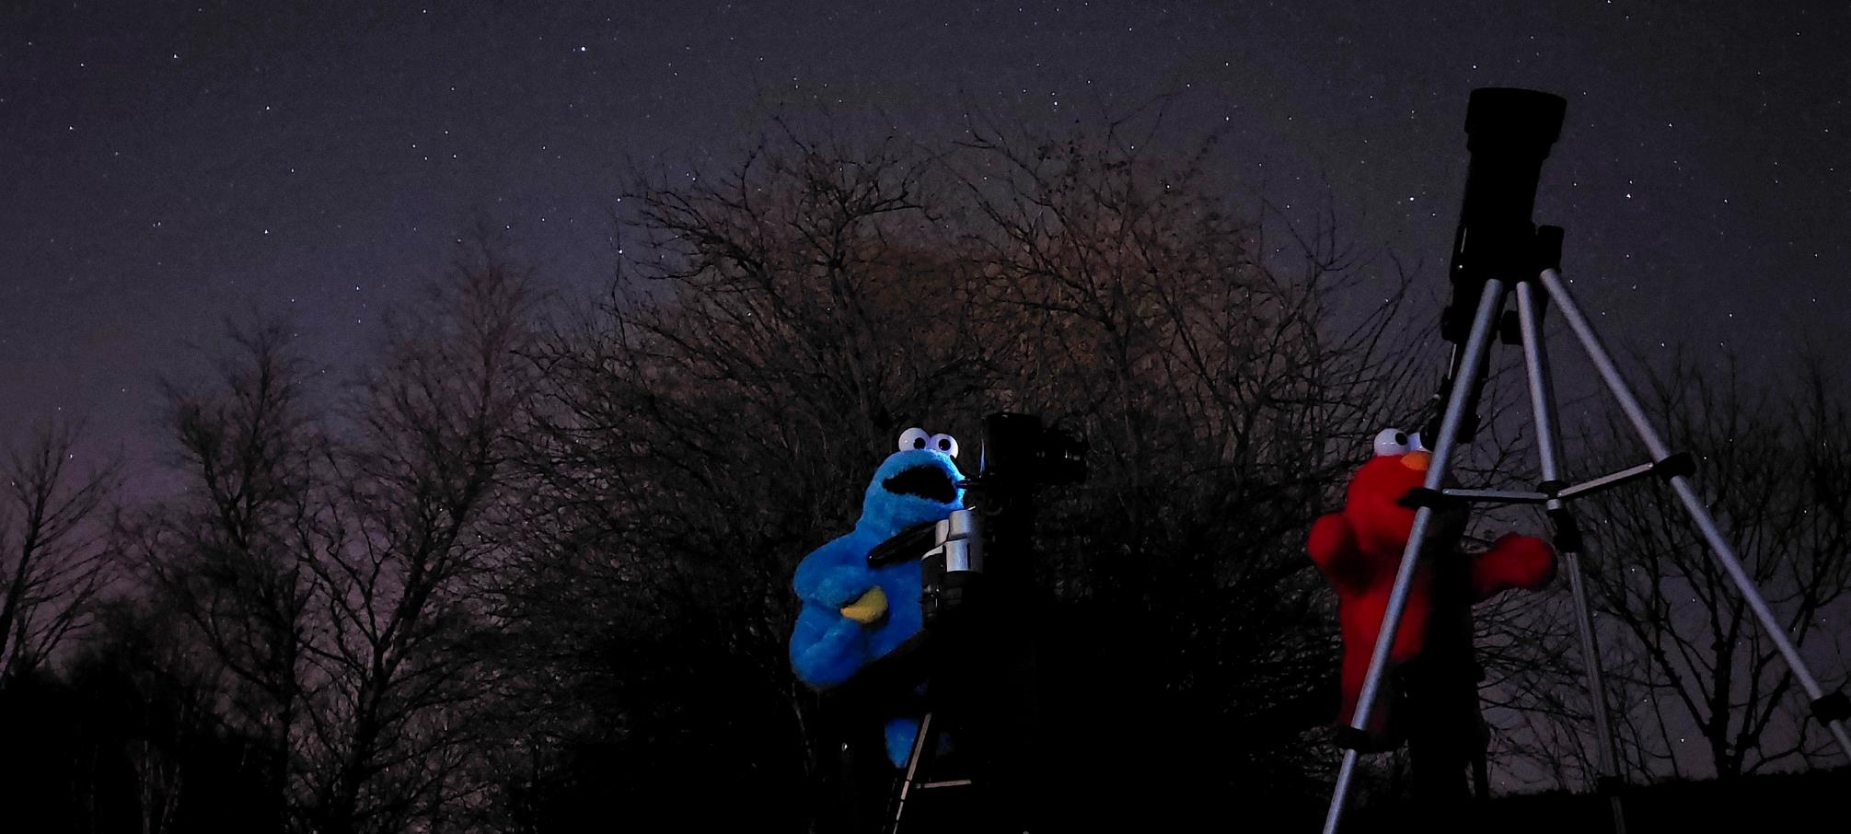
Other items to consider include
An SLR camera or a smart phone
A camera tripod
Star charts or stargazing apps
Binoculars
Folding chair or blanket
A prop for your photos!

Slide 41
Additional resources you may wish to consult
Video links on the Dark Sky Ecotourism mobile app (for android phones)
Equipment list on the Dark Sky Ecotourism application
Local safety regulations relevant to your region
Other technology you could purchase (e.g. safety devices and lighting for night boating)
Social media links

Slide 42
SECTION
05
Risk assessment

Slide 43
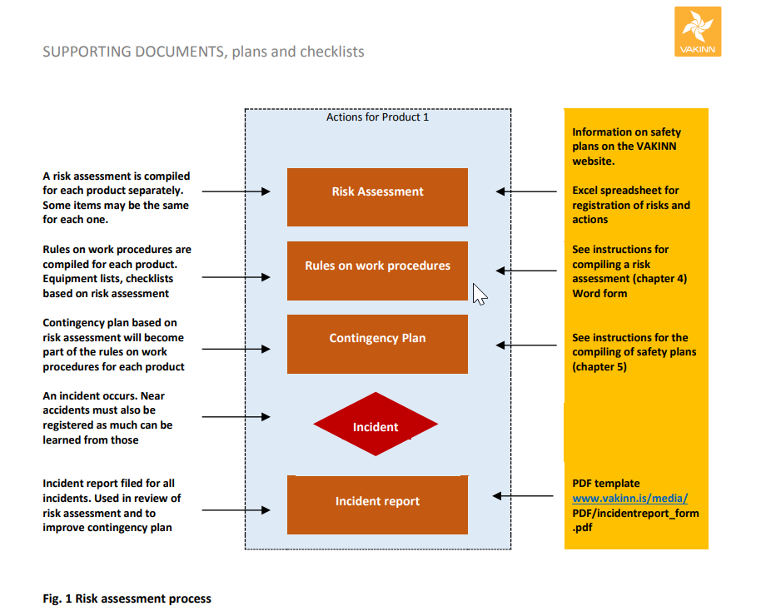
Risk assessment for your dark sky ecotourism activity
There is of course a big difference walking in dark (even with torchlight to assist you) and in daylight.
Therefore activities you are used to do in daylight need a different risk assessment. It is therefore necessary to think about possible dangers, how to avoid them and what to do if something happens.
Your first step is to be aware of the risk assessment process and use that as a form to assess possible risks. Most tourism companies are required by local law to have such a safety plan in place, see here an example from Iceland, which is based on international requirements.
Source: https://www.vakinn.is/static/files/pdf/hjalpargogn-fyrir-oryggisaetlun/safety-plan-for-tourism-31-mai-2019.pdf

Slide 44
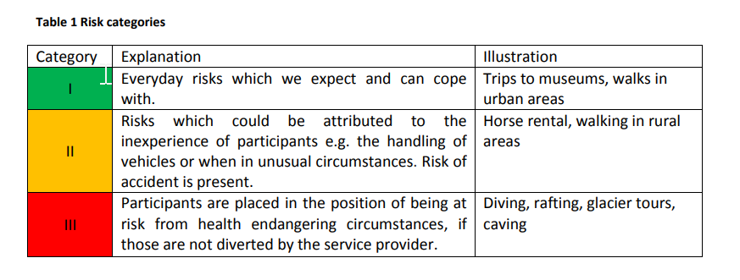
Risk assessment for your dark sky ecotourism activity
The risk assessment process is based on basic internationally recognized risk categories.
You will need to plan your dark sky ecotourism activity accordingly. If you are not used to doing this best contact a risk assessment professional or your local tourism authority that can either assist you or point you to someone who can do this.
The risk assessment is a legal requirement but at the same time it is a useful tool to help you design the dark sky ecotourism experience more thoroughly and perhaps find new ways of experiences.
Source: https://www.vakinn.is/static/files/pdf/hjalpargogn-fyrir-oryggisaetlun/safety-plan-for-tourism-31-mai-2019.pdf
Learning activity:
Choose a dark sky ecotourism experience, e.g. from module 4, and think about possible risks based on the risk categories table.

Slide 45
Follow our journey here
www.darkskytourism.eu

