Slide 1
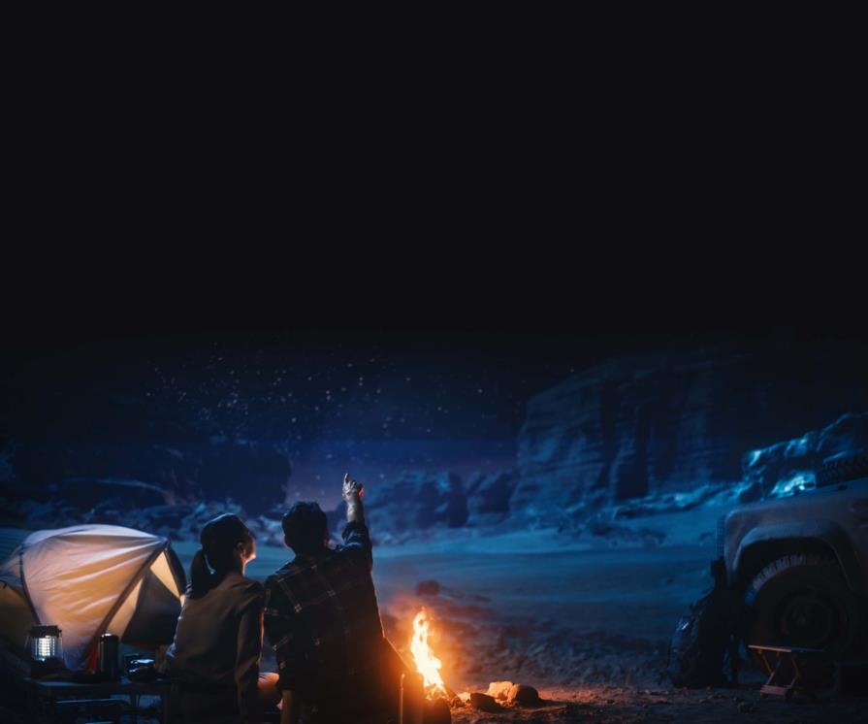
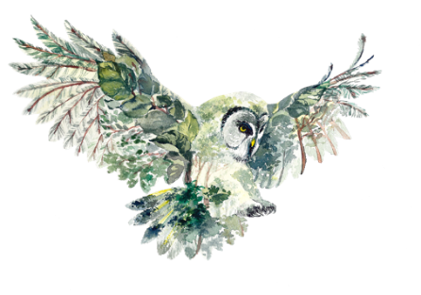


DARK SKY ECOTOURISM
Module 4 - Introduction to designing
ecotourism experience
Dark Sky Ecotourism VET Programme © 2023 by Dark Sky Ecotourism Consortium is licensed under CC BY-SA 4.0
Funded by the European Union. Views and opinions expressed are however those of the author(s) only and do not necessarily reflect those of the European Union or the European Education and Culture Executive Agency (EACEA). Neither the European Union nor EACEA can be held responsible for them.

Slide 2
Learning objectives for module 4
Within module 4, you will learn how to create your own dark sky ecotourism experience and how to manage the expectations of your audience

Slide 3
TABLE OF CONTENTS
01
Creating expectation
02
Managing expectation
03
Creating your experiences
04
Developing the story
05
So, what can you do? Examples of activities

Slide 4
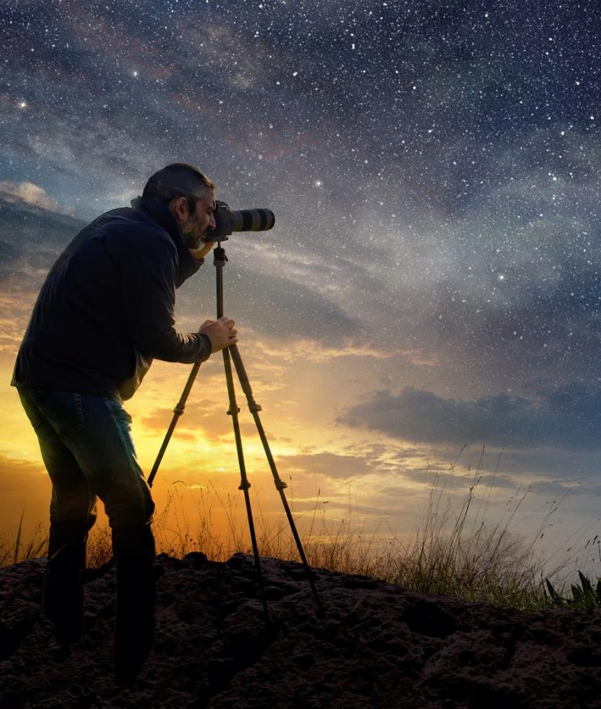
SECTION
01
Creating Expectation

Slide 5
Creating Expectation - General
Tourists will have expectations based on life experiences, including film, TV, music, social media, novels, travel guides etc.
To help create expectations you can:
Be creative with your promotional material
Tourists will engage with highly visual content – use lots of high-quality imagery and video
Don’t forget about audio content – you can record the sounds of the night (e.g. frogs, owls, crickets, etc)
Connect and capitalise with existing relevant material
Talk to guests and explain to them that they might see or do
Good social media use is critical to reach and engage audiences
Learning activity:
Go for a dark sky walk and listen to the sounds in nature. If you can, try to record them.

Slide 6
Creating Expectation - Language
Use evocative and creative language to engage guests.
Words such as the below may inspire or guide guests:
Darkness
Mystery and the unknown
Sensory awareness – encourage guests to listen, look, and touch
Being at one with nature, harmony with the environment
Spirituality and mythology
Heritage and folklore (e.g. ghost stories, navigation, religious stories)
Fear, scares and the unseen
Digital detox – encourage guest to put phones away
Learning activity:
Think of evocative and creative words for the darkness that you can use. Look for words in e.g. folklore, stories about the mythology of the dark sky and more.

Slide 7
SECTION
02
Managing Expectation

Slide 8
Managing Expectations
Sometimes the experience may not work.
The weather will not be kind. The sky will be cloudy. Conditions may not be appropriate to travel. This may disappoint guests if they have built expectations.
Consider how to manage expectations. Some ideas of what you could do include:
Proceed with the activity but tell many stories to keep guests engaged.
Offer some space themed movies for children to watch if it’s too cloudy for star gazing.
Offer a free return visit. For example, some tour businesses will offer guests a return trip if they do not see the what was offered as the main activity.
Purchase some dark sky equipment, such as night vision camera, a projected constellation for visitors, some insect samples etc.
Learning activity:
Choose an experience example module and consider what if the weather is bad (too windy, too cold etc.). What can you do to make your tour less dependent on the weather conditions?

Slide 9
SECTION
03
Creating your experiences

Slide 10
Creating Your Experience
What do you need:
Learn about your local area. Identify areas that are accessible, safe and low-cost to access.
Find an interesting location, with specific geographical features (e.g. a forest, sea, lake, mountains, architecture, ruins, abandoned industrial architecture, etc)
Visit and become very familiar with the site. You should know, for example, the parking, path, whether there is a phone signal etc. Have a plan in case of any problems. Locations for a break, restrooms, etc.

Slide 11
Creating Your Experience
Visit the site to become familiar with the site’s opportunities. Learn, for example, the flora and fauna, the best photography locations, and the traces of the animals (e.g. tracks, poop, dens etc)
Learn how to visit the site without negatively impacting the ecology and physical environment and how to teach this to guests. Follow leave-no-trace principles.
Add a wow factor. Guests will value a memorable, authentic experience. What can you do that is different? Challenge your visitors to engage with the environment and if appropriate to get outside their comfort zone.

Slide 12
SECTION
04
Developing the story

Slide 13

Dark sky ecotourism involves protecting the night sky from light pollution for the benefit of the environment, the economy, and our society.

Slide 14
Reduced light pollution can benefit habitat, nocturnal species, our sleep, our economy, safety and security.

Slide 15
Develop the Story
You are the host, and you are giving your guests an experience.
When they leave, ensure the guest is leaving with a special memory.
Therefore, think of the experience you are designing as your product. Take pride in every aspect of it to ensure it is memorable and transformational for the visitor.
You want your guest to become immersed in the experience and to become an ambassador for your business, communicating that your dark sky ecotourism experience was the best experience they have had as a tourist.
Tell the guest why dark sky ecotourism is good for the environment, health, biodiversity and economy.

Slide 16
Post-visit Feedback and Memories
The final step in experience design is the legacy of each visitor’s experience
If the experience was positive for the visitor, you can benefit from their feedback.
Learn what you can do to improve from constructive criticism.
Ask guests to share photographs, use hashtags on social media, to refer their friends, to return. Word of mouth will be your best promotional tool. Request that they leave reviews on social media platforms, on Google, on Trip Advisor etc.
Think about merchandising opportunities. Your guest just had a unique experience – a t-shirt, bracelet, mug, key ring etc., can be a great memory aide for them to take away with them.

Slide 17
SECTION
05
So, what can you do? Examples of activities

Slide 18
So, what can you do?
Around Europe, there are many examples of outdoor nighttime touristic activities in remote and rural areas.
Take advantage of your local geography. You might be in a wine-producing region in Southern Italy or a Northern Icelandic village. Both offer vastly different opportunities, but the important thing is to consider what you have that is unique and will interest visitors.
Some examples of activities you could do with guests include:
Nighttime safari walks
Nighttime walks with mythology, folklore and ghost stories
Adventure activities, such as nighttime zip-lining, nighttime kayaking
Health and wellness activities – nighttime yoga

Slide 19
Examples of Activities (continued)
Night orienteering
Photography lessons – photograph the moon, eclipses, the Northern Lights, the Milky Way etc.
Identifying flora, and fauna – e.g. try our activity for identifying insects at night
Nighttime gastronomy experiences in the darkness
Tranquillity moorings – if you are in a location with rivers, lakes etc – find a quiet place to stop your boat and listen to and become in harmony with nature
Citizen science projects – e.g. many projects want citizens to count the stars, identify plant life, record sightings of vulnerable species etc
Cold water swimming, hot springs and spas, forest bathing etc – engaging your body and senses with the environment
Breathing exercises and focussing on the quality of the air
Learning activity:
Read through all six or a chosen few experience sample/case studies and identify an area in your region where you could do the same or similar dark sky ecotourism activity. Here you can use this slide and the one before to give your ideas

Slide 20
Here are some low-cost, easy to learn, and enjoyable to implement ideas.

Slide 21

Educate your guests and learn together with them

Slide 22
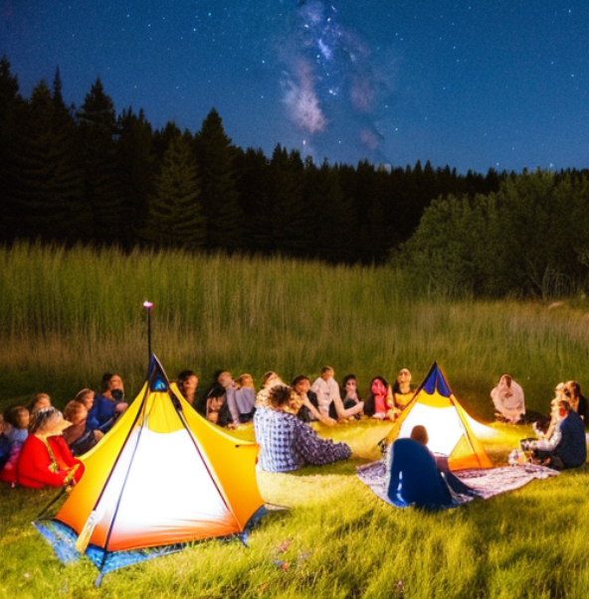


First, start a conversation.
Ask visitors about their home areas.
What do they know about light pollution in their local area or home country?
What do they know about the impact of light on ecology from their home region?

Slide 23

Focus on the Transformational Experience
Create memories for your guests

Slide 24
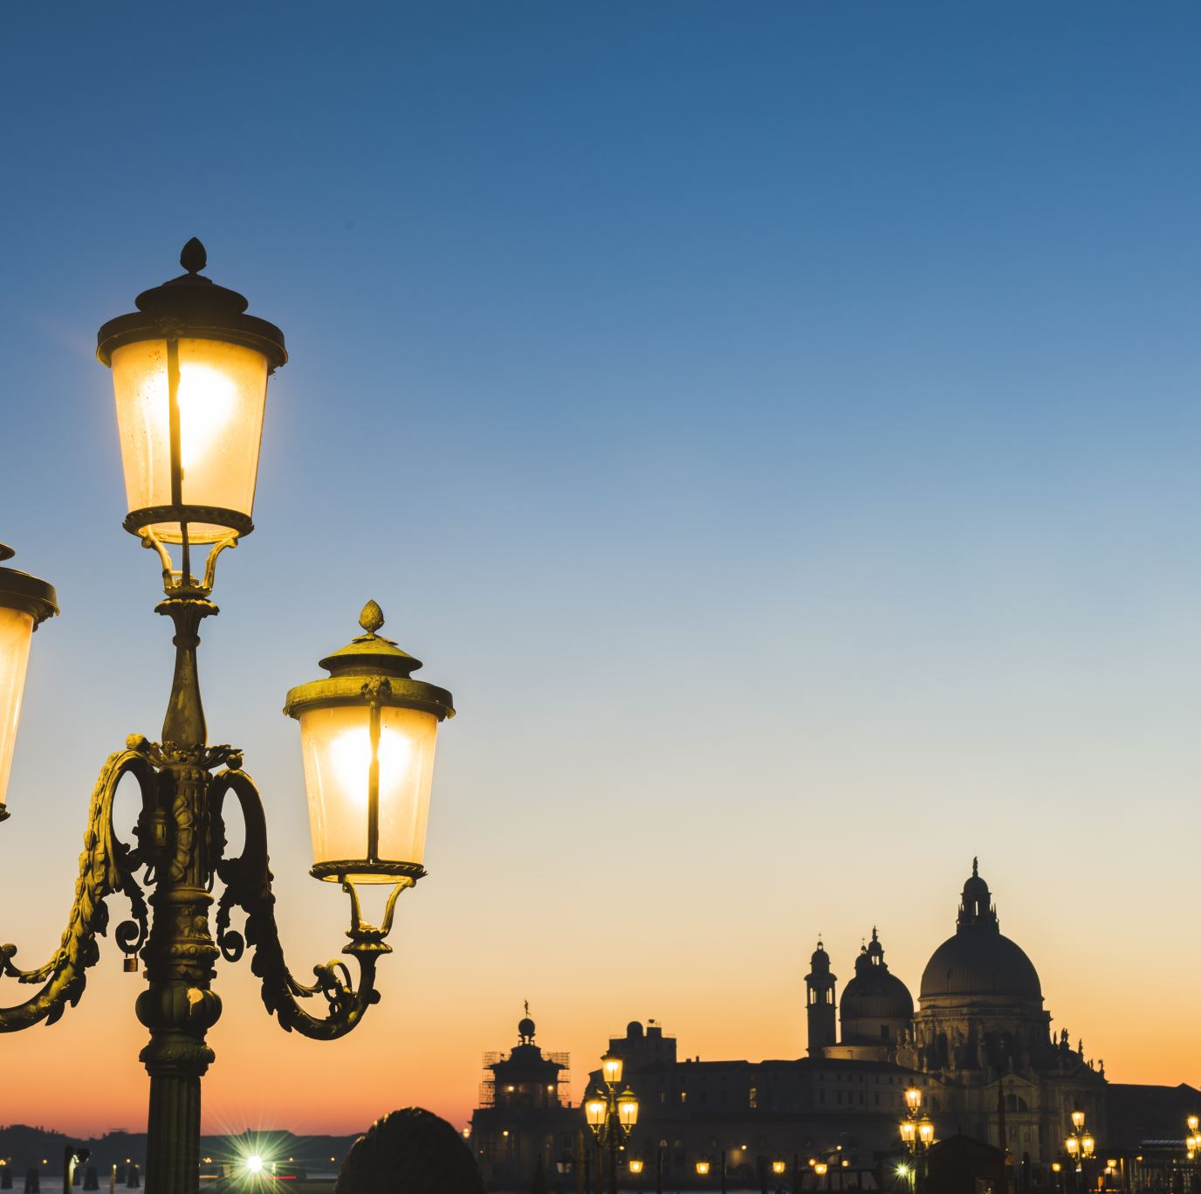
Give your guests some examples from your locality which are negatively impacted by artificial light.
Next, talk about your local light pollution reduction initiatives.
Third, ask visitors how they think they can help, or how they think local initiatives could be improved.
Finally, prompt guests to think about the benefits to their sleep, their stress levels and their environmental awareness.

Slide 25

Use technology to enhance your guests’ experience

Slide 26
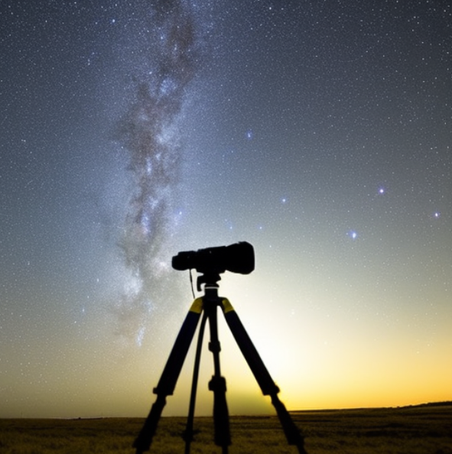
Star gaze with telescopes or binoculars
Try laser pointers to pinpoint stars, nebulae or other astronomical objects (observe local regulations)
Try night photography with your phone or with more specialised cameras

Slide 27

Focus on the senses: Touch, hear, see, smell and taste the night

Slide 28
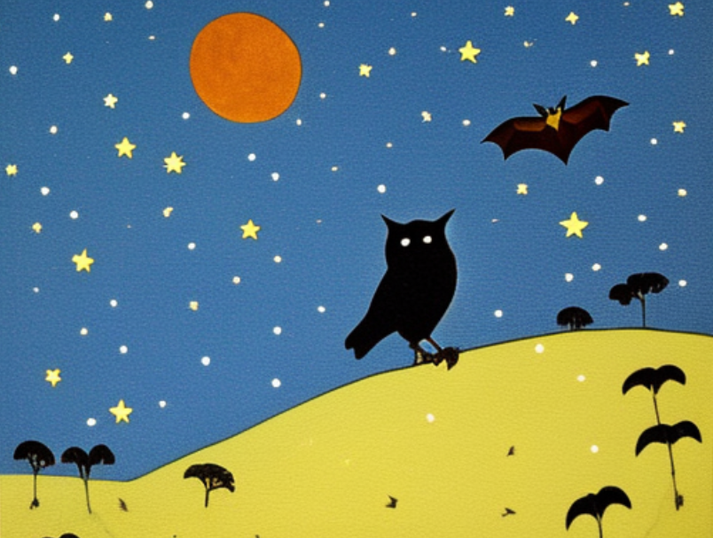
Listen in silence to the sounds of the region
Maybe you can hear bats, owls, insects, or some local mammals
Use night capture cameras to view some more elusive local wildlife
Try breathing exercises with your guests to focus on the fresh night air

Slide 29

Participate in some night-time physical activities

Slide 30
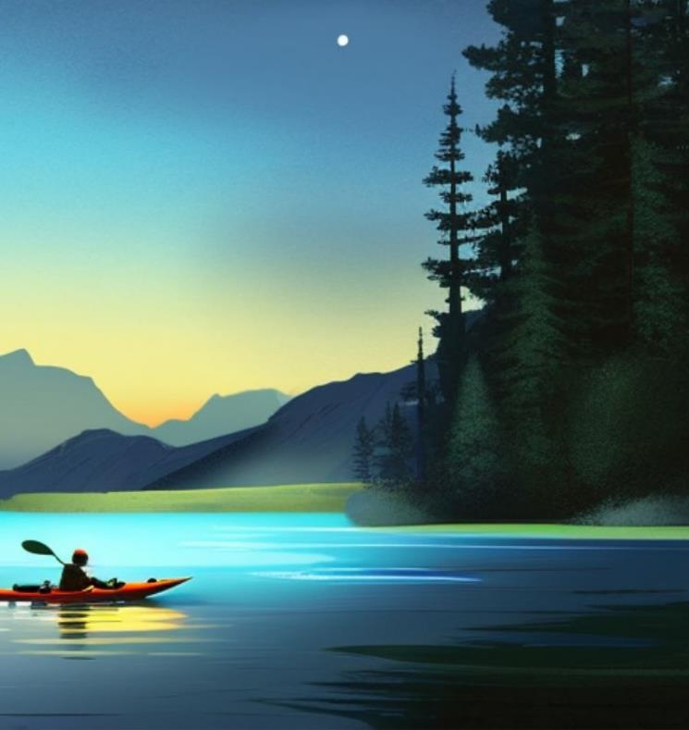
Create a night safari walk
Try out some night-time water sports, such as kayaking, or stand-up paddle boarding, if local conditions permit
Wellness exercises - forest bathe, yoga, and meditation are all increasingly popular with guests.

Slide 31

Run customised activities for children

Slide 32
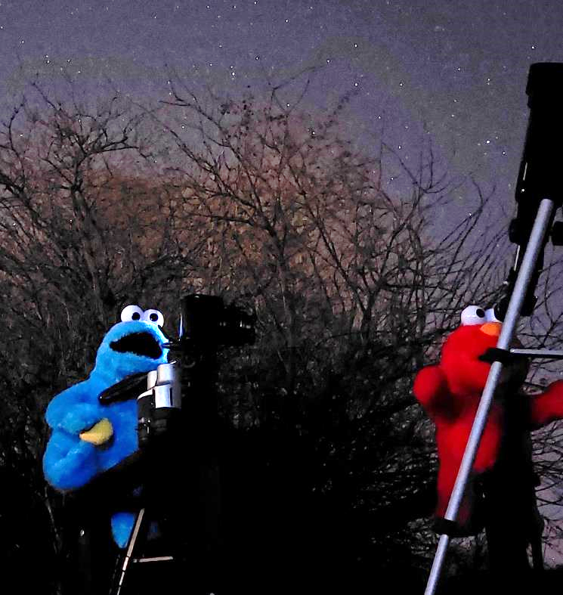
Identify insects and plants when in the field or keep samples at the base.
Explain how these need the correct habitat.
Keep it fun! Perhaps photograph soft toys under the night sky
Draw pictures of what you saw and heard on return to base – use imagination!

Slide 33

Cultural and history-based activities

Slide 34
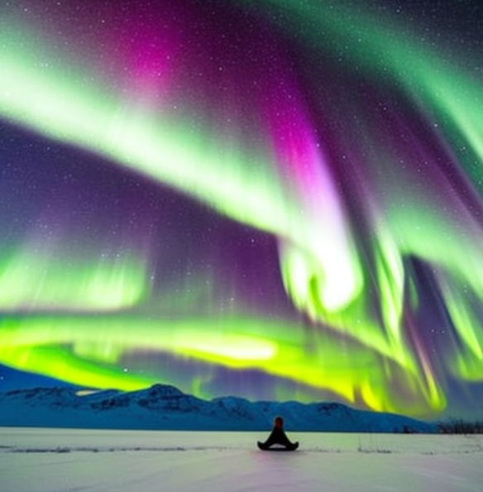
Tell stories: the night sky is full of folklore, navigation histories, exploration stories, and local history.
Learn some stories and recount to you guests.
Co-create with your guests. Why not make up some ghost stories together?
Learning activity:
Create a short story (3-5 lines) that you feel can describe your activity in a way that would attract guests

Slide 35

Show off the wonders of the night sky

Slide 36
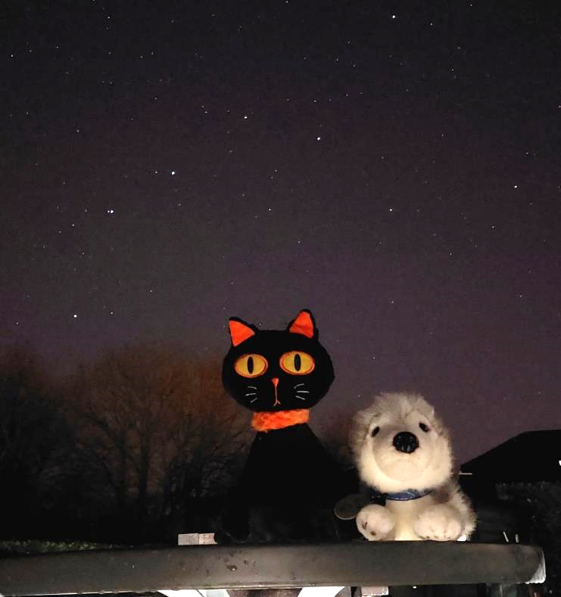
Learn some basic astronomy to show your guests. What planets and constellations can you easily find?
We suggest to start off with:
  Finding Canis Major (also known as the Plough/ The Wagon).
  Can you find the North Star (Polaris)?
  Can you spot Mars? What about Jupiter?

Slide 37
Further experience examples:
As a part of this module, you have 7 smaller modules that describe dark sky ecotourism experiences you can be inspired by

Slide 38
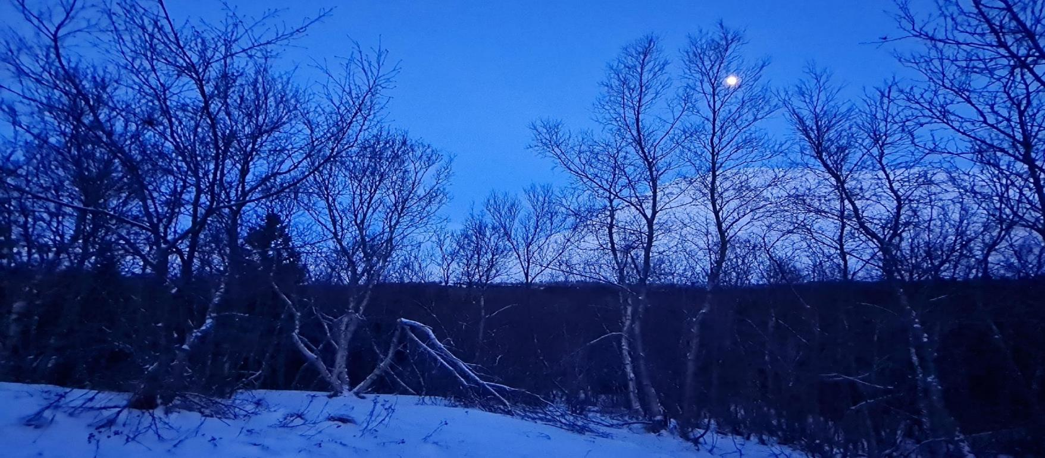

Follow our journey here
www.darkskytourism.eu
Dark Sky Ecotourism VET Programme © 2023 by Dark Sky Ecotourism Consortium is licensed under CC BY-SA 4.0
Funded by the European Union. Views and opinions expressed are however those of the author(s) only and do not necessarily reflect those of the European Union or the European Education and Culture Executive Agency (EACEA). Neither the European Union nor EACEA can be held responsible for them.

