Slide 1
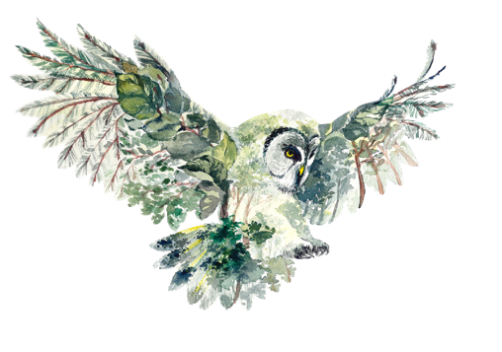
DARK SKY ECOTOURISM MODULE 5
After the Experience -
A Dark Sky Ecotourism Message
Dark Sky Ecotourism VET Programme © 2023 by Dark Sky Ecotourism Consortium is licensed under CC BY-SA 4.0
Funded by the European Union. Views and opinions expressed are however those of the author(s) only and do not necessarily reflect those of the European Union or the European Education and Culture Executive Agency (EACEA). Neither the European Union nor EACEA can be held responsible for them.

Slide 2
Learning Objectives for Module 5
This module focuses on the ‘message’ you want your guests to take away from your dark sky experience and the feeling you want to leave your audience with.

Slide 3
TABLE OF CONTENTS
Creating an Interesting Dark Sky Ecotourism Message
01
02
Use Nature Interpretation
03
Examples of Dark Sky Ecotourism essage
Funded by the European Union. Views and opinions expressed are however those of the author(s) only and do not necessarily reflect those of the European Union or the European Education and Culture Executive Agency (EACEA). Neither the European Union nor EACEA can be held responsible for them.

Slide 4
SECTION
01
Creating an Interesting Dark Sky Ecotourism Message

Slide 5
Use all your senses to create an experience:
LISTEN
SMELL
TOUCH
TASTE
LOOK
By doing so we are more likely to get our ecotourism message across to our guests.
Learning activity:
Take one experience module and create one small dark sky experience based on each of your senses: Listen, smell, touch, taste and look.

Slide 6
Creating an Interesting Dark Sky Ecotourism Message
As a responsible tourism business, you want to connect your guests to nature. As a way of doing that, we can use the methods of nature interpretation. This helps us connect our guests to nature at our specific location and in general the importance of nature and healthy ecosystems.
When creating your dark sky ecotourism message consider the following:
What do you want to say?
How can I say it without words, i.e. as part of the experience throughout the dark sky ecotourism experience? Here you can rely on different senses, e.g. listen to a bird singing, the waves, the wind etc.
How can my ecotourism message affect the behaviour of my guests?
The lasting impact of ecotourism message on the customer satisfaction.

Slide 7
When adding an ecotourism message to your dark sky experience consider the following:
Light pollution is increasing at 10% a year
99% of the European population cannot see the night sky clearly
Light pollution has a negative impact on:
Human health
Biodiversity
It is important to convey the ecotourism benefits of dark sky experiences to your visitors
Learning activity:
Take the above information and try to create one paragraph that can convey to your guest the importance of the dark sky to human health. Can you use other senses to enhance what you are saying? Keep here in mind the aims of nature interpretation, see slides 12 and 13.

Slide 8
Creating an Interesting Dark Sky Ecotourism Message
The goal of your message is for people to understand the importance of darkness for the life of many organisms, e.g. autumn butterflies, for our own night sleep, insect foraging, etc.
We try to use all our senses – what we see, hear, smell, taste and touch.
The aim is to incorporate all these senses during our night time experiences so that we – ideally – do not need to put our message into words or one sentence but rather that the guest comes to the same conclusion as we do.
Research shows that rather by doing (than being told) we are more likely to change our behaviour, to incorporate the ecotourism message into our own lives.
8

Slide 9
Remember to focus on:
The preservation of natural beauty
The benefit of darkness to local wildlife
Ecosystem health

Slide 10
SECTION
02
Use nature interpretation to create a dark sky ecotourism message

Slide 11
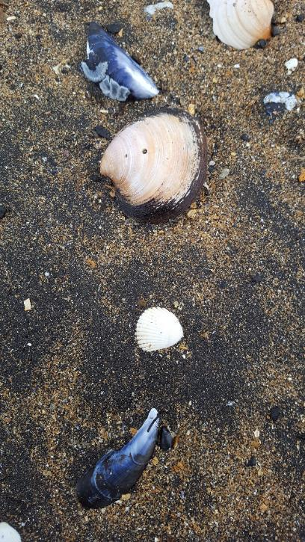
Use Nature Interpretation to Create a Dark Sky Ecotourism Message
Nature interpretation is a tool we can use to help us with designing an experience. The 6 following principles help us to create a well-defined theme or topic that leads visitors throughout the walk and introduces the dark sky, its creatures, ecosystem and value in an interesting way:
Interpretation that does not somehow relate what is being displayed or described to something within the personality or experience of the visitor will be sterile. Interpretation should be personal to the audience.
Information, as such, is not interpretation. Interpretation is revelation based on information. Successful interpretation must do more than present facts.
Interpretation is an art, which combines many arts. Any art is to some degree teachable.
(Tilden, F. 1977. Interpreting Our Heritage. 3rd edition. Chapel Hill: The University of North Carolina Press.)
11

Slide 12
Use nature interpretation to create a dark sky ecotourism message
The chief aim of interpretation is not instruction, but provocation. Interpretation should stimulate people into a form of action.
Interpretation should aim to present a whole rather than a part. Interpretation is conceptual and should explain the relationships between things.
Interpretation addressed to children should not be a dilution of the presentation to adults but should follow a fundamentally different approach. Different age groups have different needs and require different interpretive programs.
(Tilden, F. 1977. Interpreting Our Heritage. 3rd edition. Chapel Hill: The University of North Carolina Press.)
12

Slide 13
SECTION
03
Examples for a Dark Sky Ecotourism Message

Slide 14
Examples:
Our Commitment to Ecotourism
Show what your company does as an ecotourism company
At our Ecotourism Company, we prioritise the preservation of our planet's natural beauty and cultural heritage.
“We work closely with local conservation groups, actively engaging in habitat restoration projects to safeguard and revive the continent's native species.”
14

Slide 15
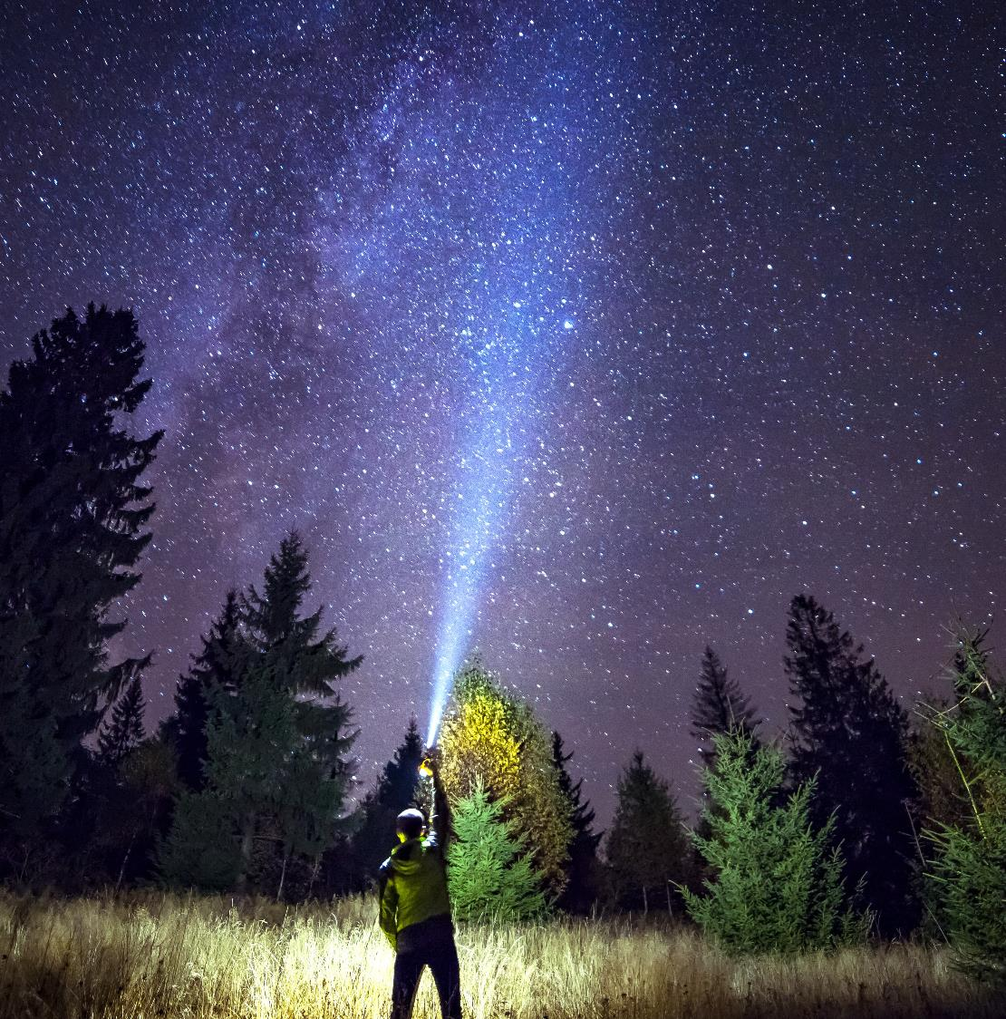
Examples:
Our Commitment to Ecotourism
Show what your company does as an ecotourism company
”
Our mission is to provide travellers with unique, sustainable experiences that leave a positive impact on local communities and the environment.
“We collaborate with European rural communities, offering eco-friendly accommodations and experiences that celebrate regional cultures and traditions, ensuring that a portion of every booking directly benefits these communities.”
15

Slide 16
Examples:
Our Commitment to Ecotourism
Show what your company does as an ecotourism company
Join us in creating a greener, more responsible future for travel.
“By choosing our ecotourism adventures in Europe, you're supporting sustainable tourism practices that reduce waste and carbon emissions. We're committed to the European Green Deal, working towards a greener and more sustainable future for travel across the continent.”
Learning activity:
Read the examples on slides 15 to 17 and create an ecotourism message for your tourism business similar in length and form.
16

Slide 17
Follow our journey here
www.darkskytourism.eu
Dark Sky Ecotourism VET Programme © 2023 by Dark Sky Ecotourism Consortium is licensed under CC BY-SA 4.0
Funded by the European Union. Views and opinions expressed are however those of the author(s) only and do not necessarily reflect those of the European Union or the European Education and Culture Executive Agency (EACEA). Neither the European Union nor EACEA can be held responsible for them.

